Slide 1
Data Privacy
Keith Burghardt, Kristina Lerman
USC Information Sciences Institute
DSCI 552 – Spring 2021
March 29, 2021
Many slides borrowed from Korolova’s WSDM talk and Machanavajjhala, Hay, and He’s tutorial “Differential Privacy in the Wild”

Slide 2
Central Problem
Imagine you want to extract sensitive information from a population
STD results
Epidemiological surveillance
Illegal activity
Has crime decreased?
Medical results
Effectiveness of hospitals, accidences
Political opinions
Outcome of future elections
Where you went and when (for road network policies)
How do you extract this information without revealing the person?

Slide 3
Anecdote
15 years ago, my old high school had a Q&A session
Students would write private questions about their sexuality on a notecard
Faculty would collect these notecards, both with and without questions on them
Faculty would shuffle these questions and answer them
Anonymity goals achieved?
We would (expect to) not know who or even if students ask questions
Safety of this approach depends strongly on not knowing who asks questions
Outcome: exactly 1 student declared she had 2 questions to ask. Only 2 questions were asked in the Q&A session, thus we could immediately infer sensitive information about a student we didn’t know before

Slide 4
Ensuring Anonymity
Why did this method fail?
It required assumptions that could not possibly be fully realized: several students asking questions, and no students determining who wrote these questions
Was there a better way?
We want methods such that adding or removing your datapoint will not significantly change statistics (e.g., mean, median mode or the # questions asked)
The questions should not be uniquely matched to the person using public data
In this case, questions should have been asked outside of class, and discretely collected, e.g., in a box.
Several blank and question-filled cards could be added to “salt” the statistics, thus knowing someone dropped a card in a box should not necessarily uncover who had a question

Slide 5
Methods to Ensure Privacy
Trusting the source
Protected server
Attacks
Model inversion attacks
Initial forays: k-anonymity
Differential Privacy

Slide 6
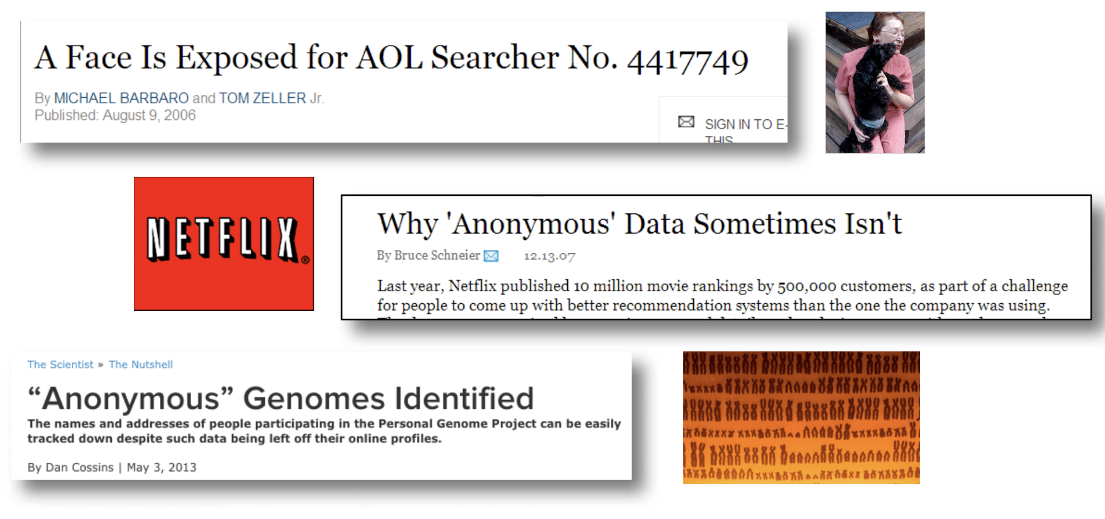
“Anonymous” is not enough
Machanavajjhala, Hay, He. Differential Privacy in the Wild

Slide 7
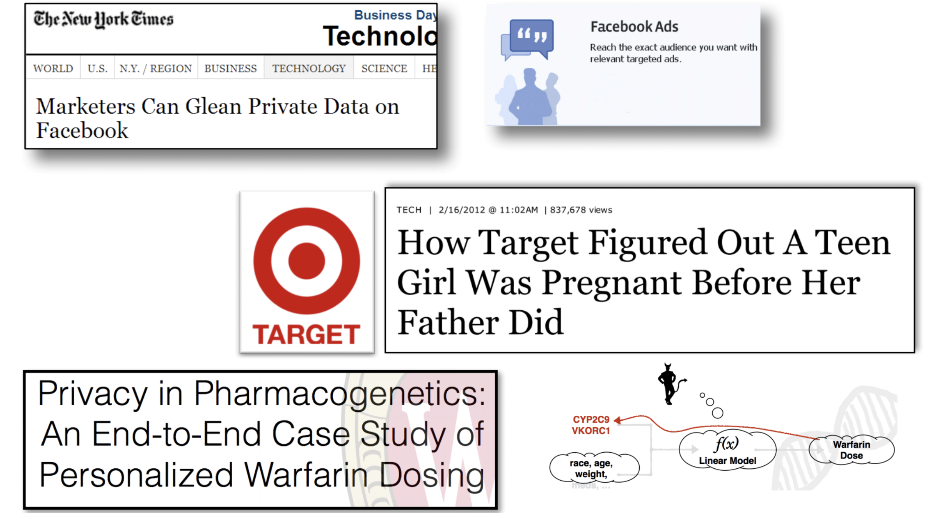
Models themselves can reveal private information

Slide 8
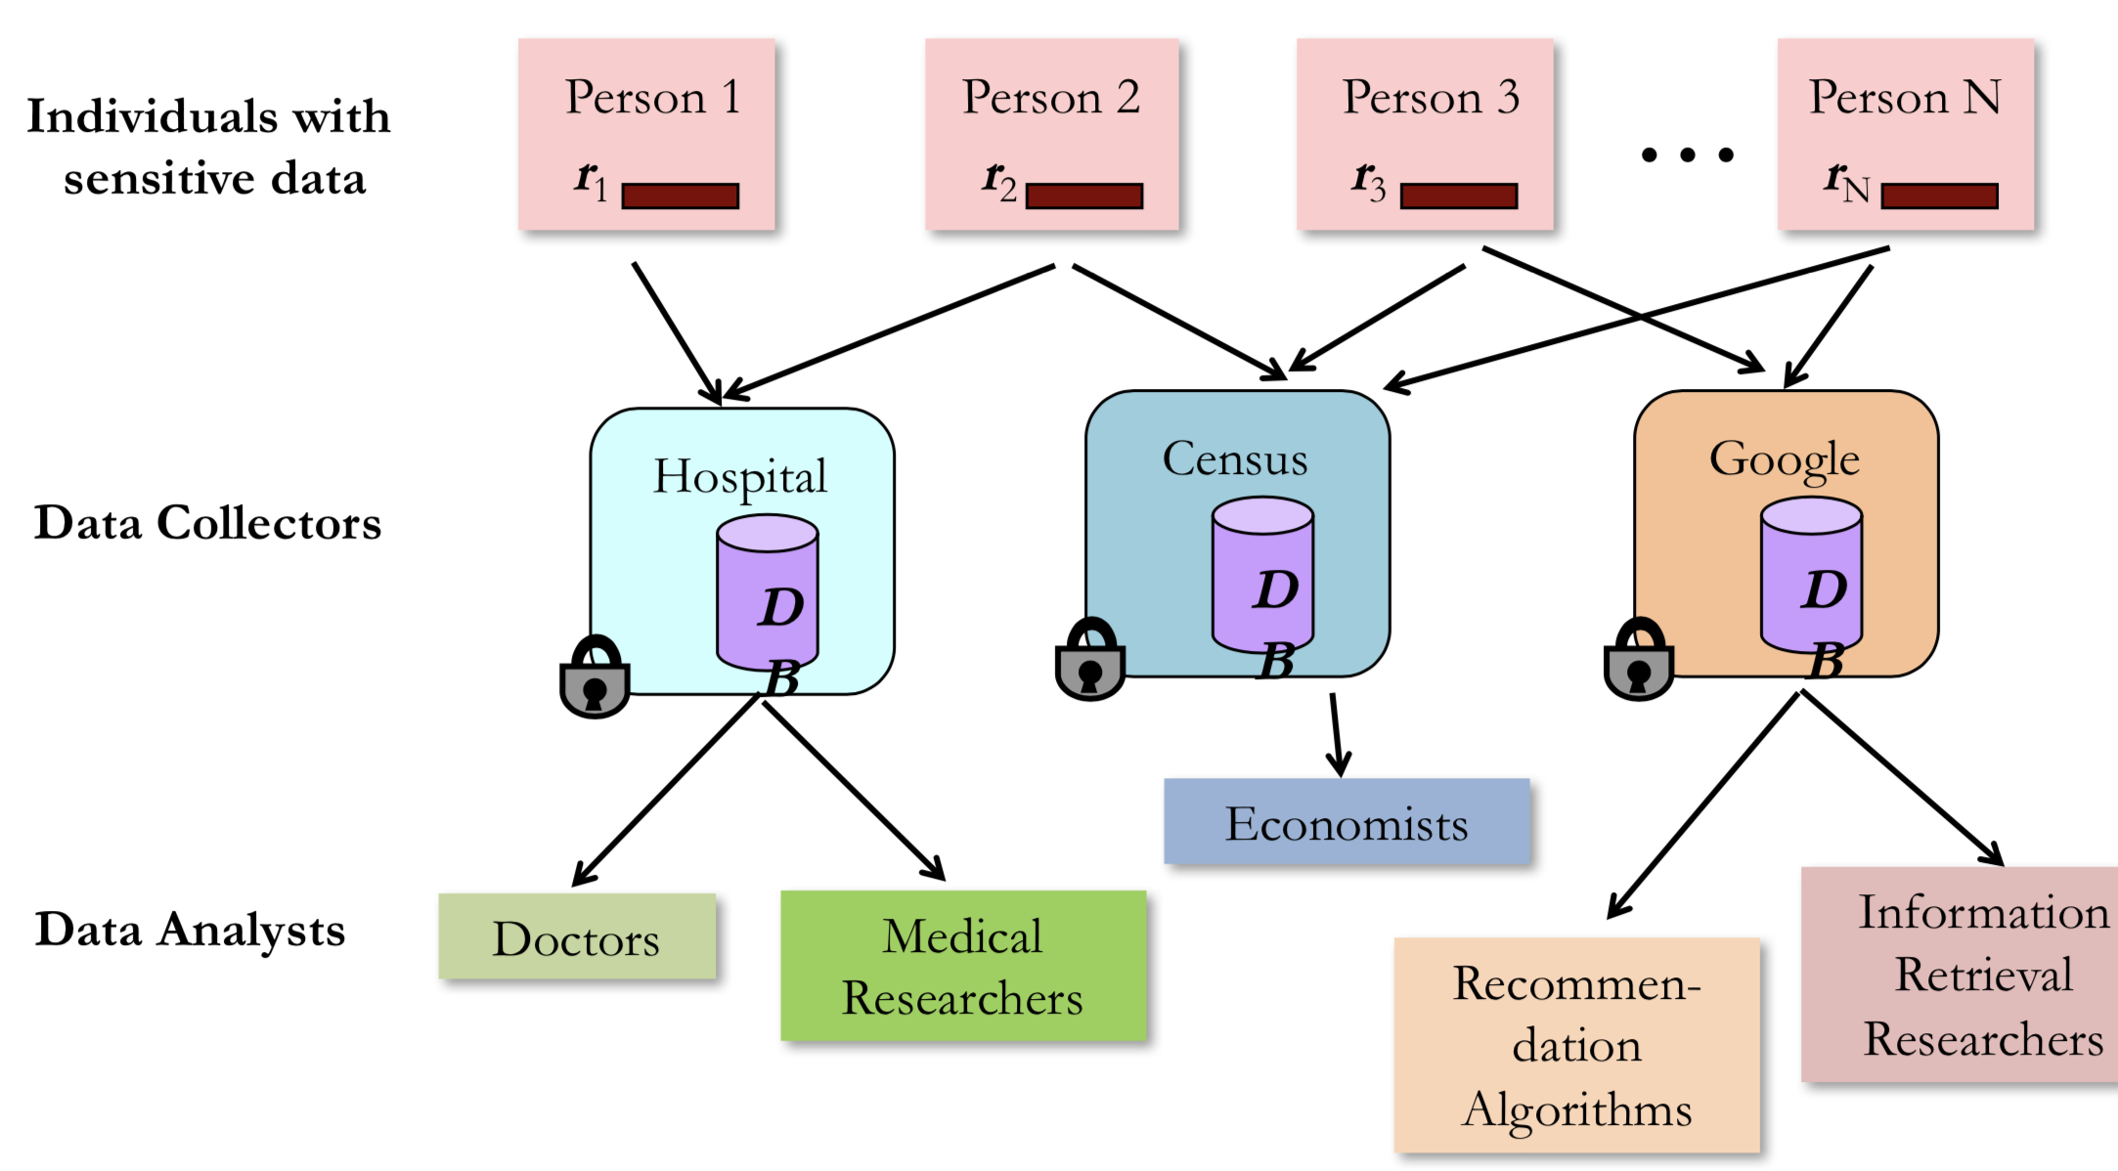

Slide 9
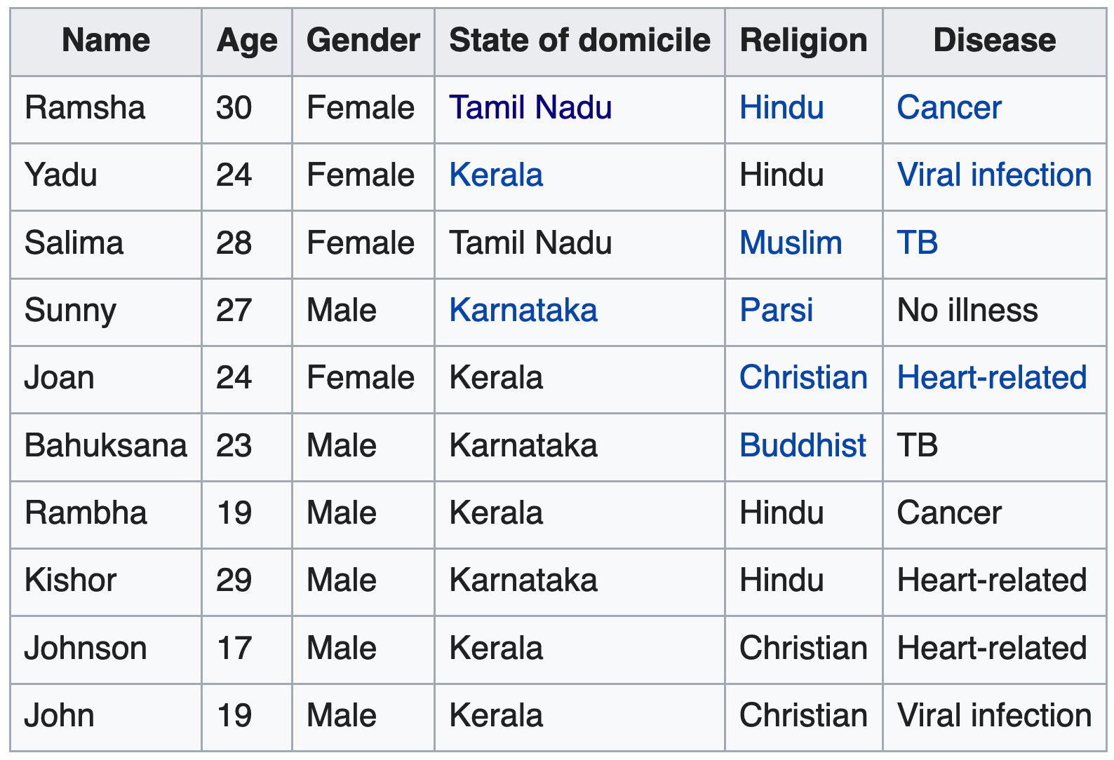
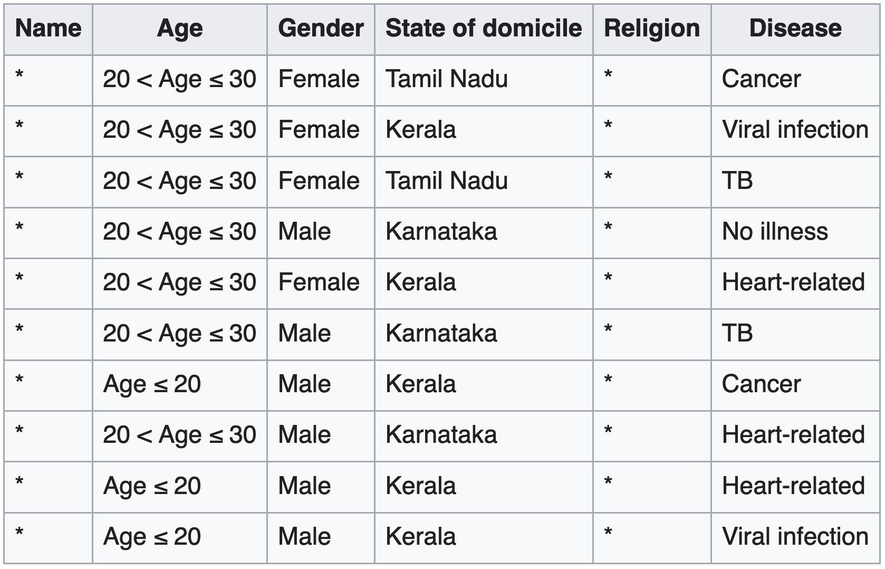
Naïve Anonymity: k-anonymity
https://en.wikipedia.org/wiki/K-anonymity

Slide 10
k-anonymity Methodology
Data is 2-anonymity with respect to the attributes 'Age', 'Gender' and 'State of domicile’
Any combination of these attributes found in any row of the table there are always at least 2 rows with those exact attributes.
Attributes available to an adversary are called quasi-identifiers.
Each quasi-identifier tuple occurs in at least k records for a dataset with k-anonymity
2 types of anonymity:
Suppression (data -> *)
Generalization (age -> “20<age<=30”)

Slide 11
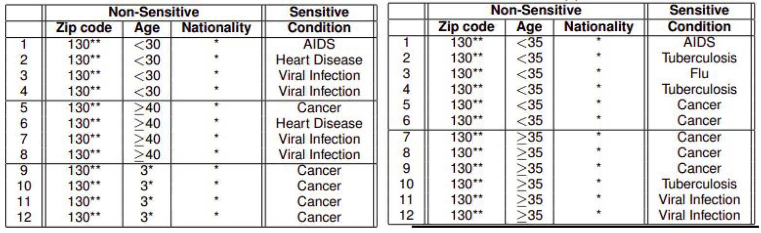
Is this Anonymous enough?
Hospital 1
Hospital 2
Imagine a patient, Alice, has an employer who knows that
she is 28
lives in zip code 13012
and visits both hospitals
-> the employer now knows that she has AIDS.
Ganta et al., 2008

Slide 12
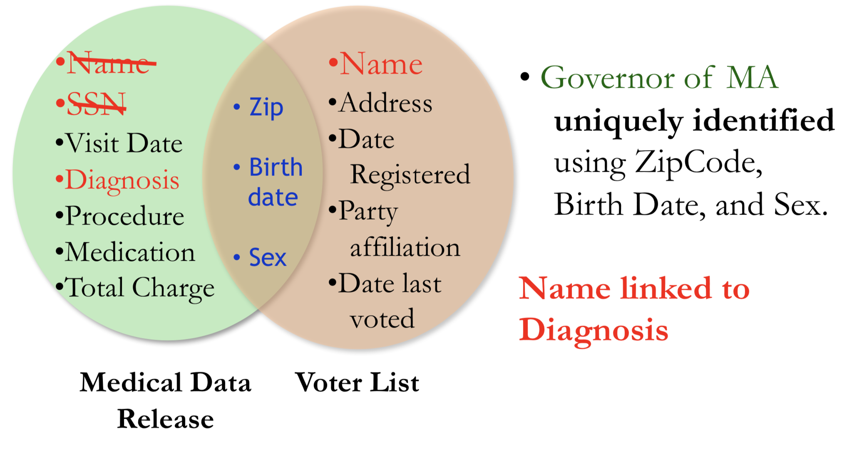

Slide 13
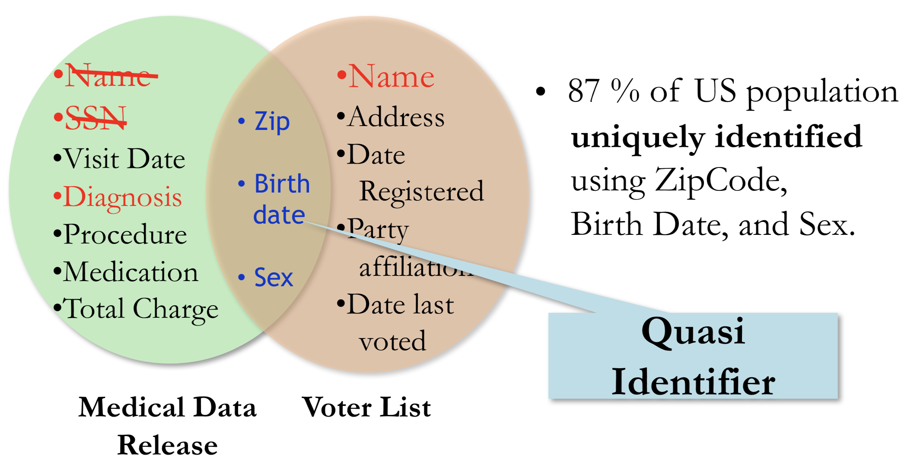
(just a little extra data could identify even better)

Slide 14
Example of how this can be achieved in large anonymous datasets
Netflix Prize:
October 2006, back when Netflix was only a DVD rental service, they created a “Netflix Prize” to find better ways to recommend movies
100M movie ratings from 480K users
“Is there any customer information in the dataset that should be kept private?”
“No, all customer identifying information has been removed; all that remains are ratings and dates. This follows our privacy policy”
This was simply wrong
Narayanan and Shmatikov, 2008

Slide 15
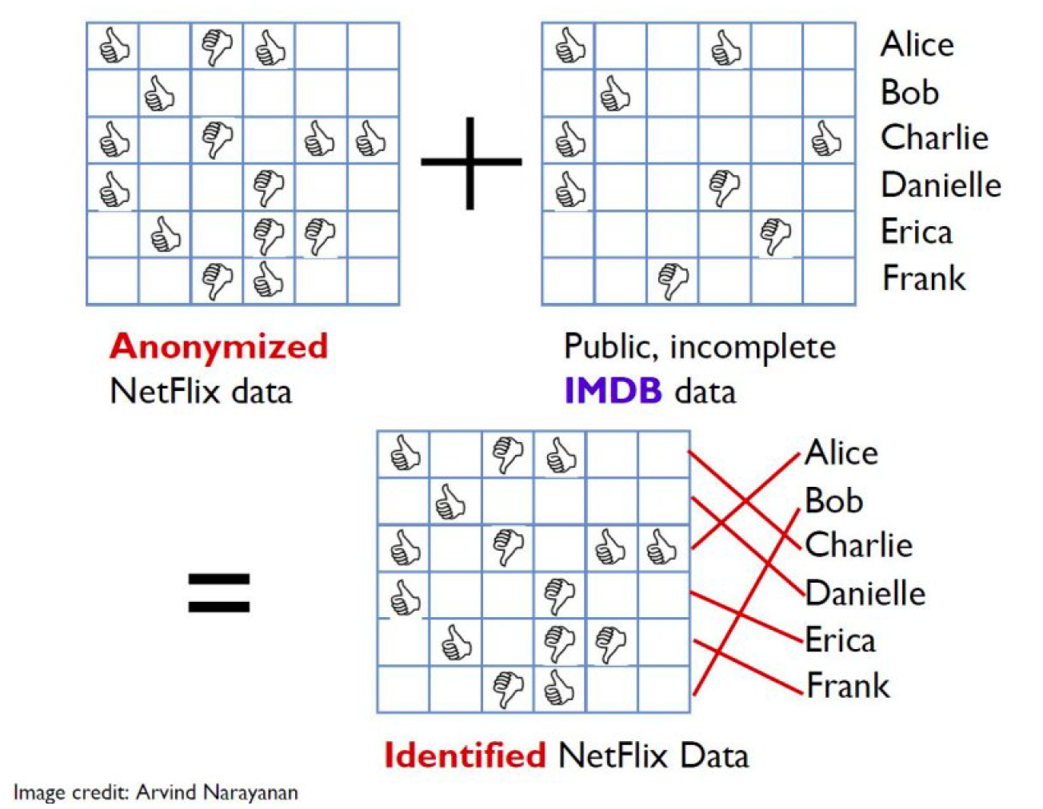
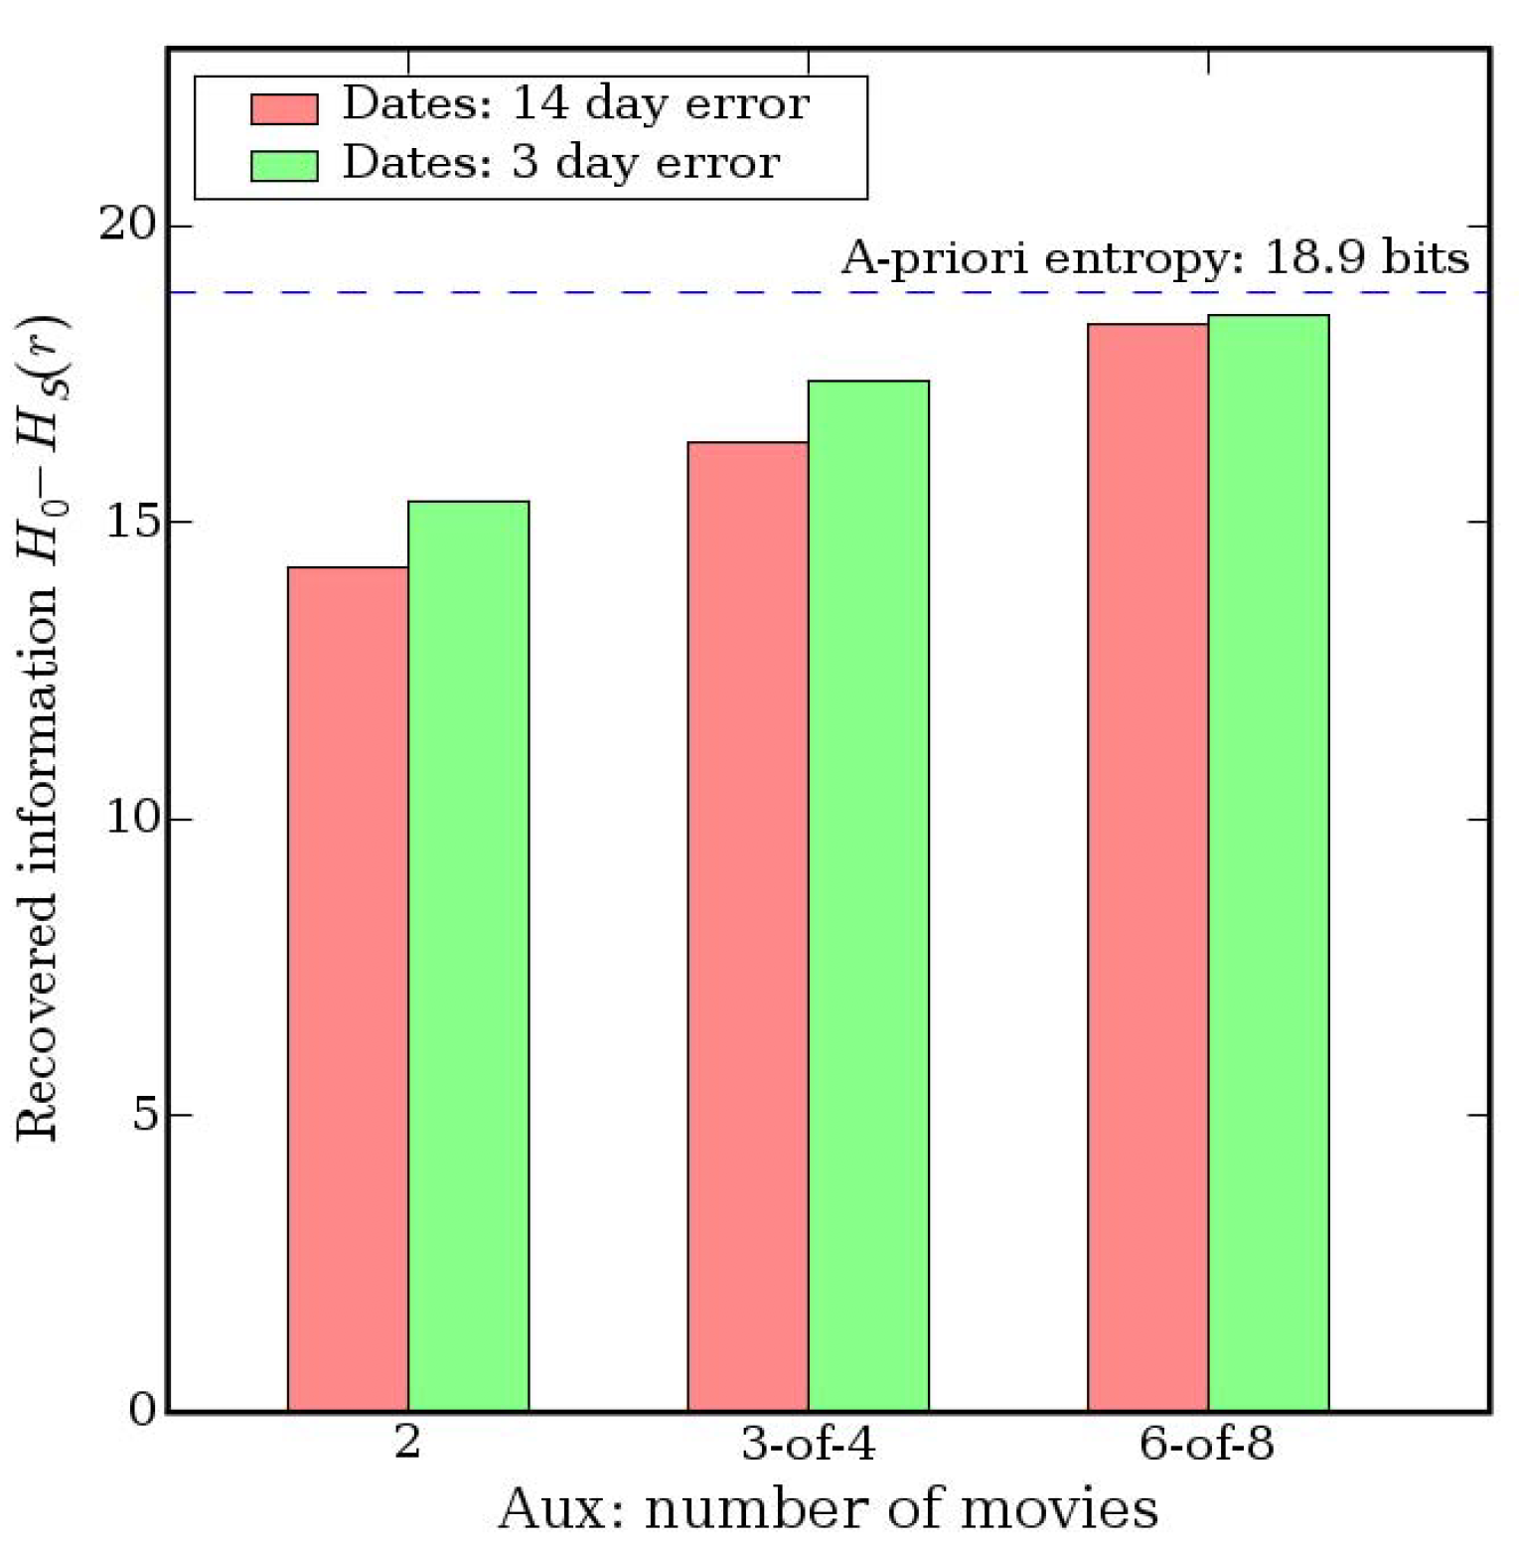
Deanonymizing What You Like
Narayanan and Shmatikov, 2008
http://www.gautamkamath.com/CS860-fa2020.html

Slide 16
Privacy in Netflix
All you need is 6 of 8 movies you like to be correctly identified, and we can find your entire history on Netflix with high accuracy
”Perturbed” data was insufficient (in a few examples, less than 1% of data of a user was perturbed”
Deanonymization is difficult: too much data deanonymized and the training data is garbage
Why is it important?
It is not so much whether the average user will care, but whether any user will care that their data is available
Violates Video Privacy Protection Act of 1988

Slide 17
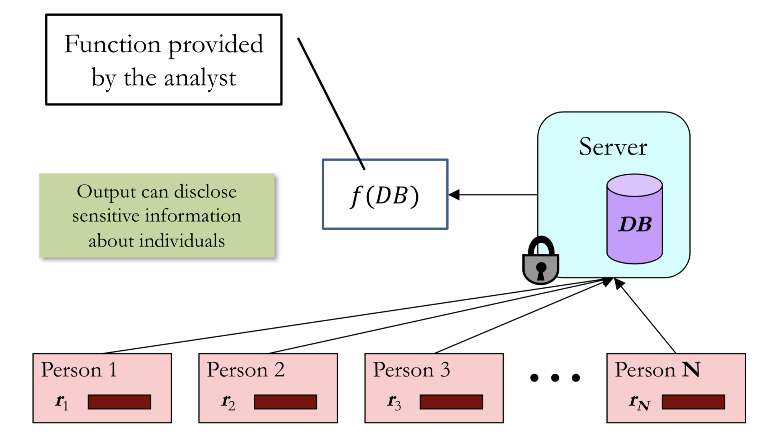
Naïve Construction Creates Privacy Breaches

Slide 18
Why naive approaches Fail
An adversary can come up with a clever combo of queries & background knowledge
Too cumbersome to reason about

Slide 19
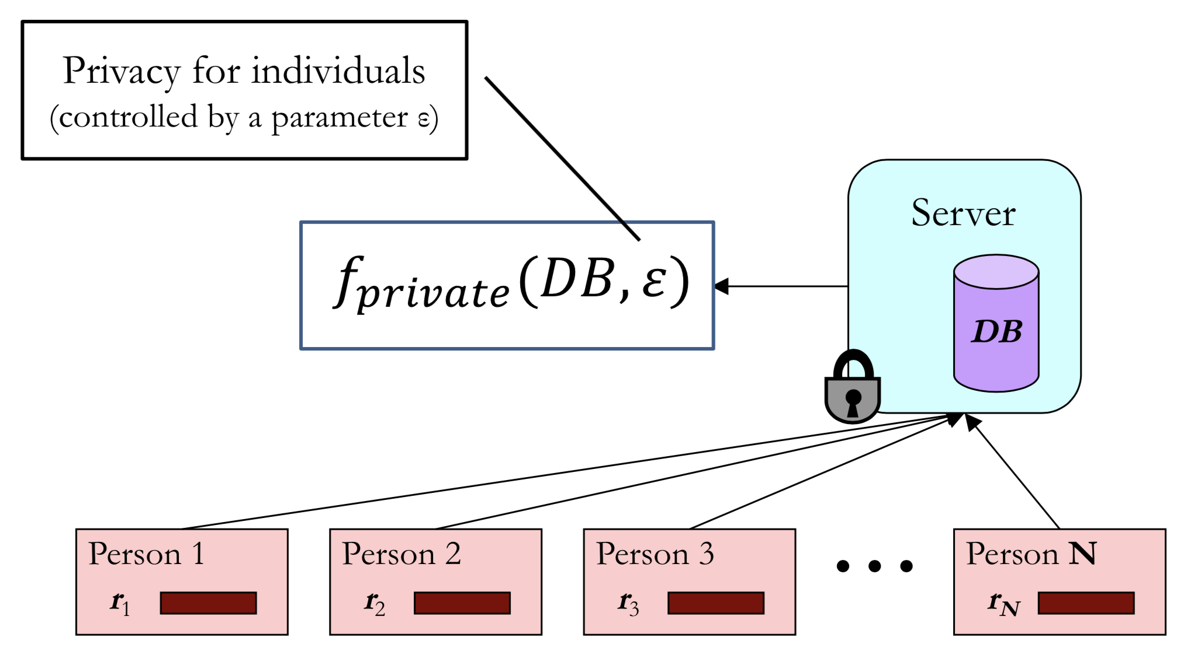
We want to ensure reasonable trade-off between privacy…

Slide 20
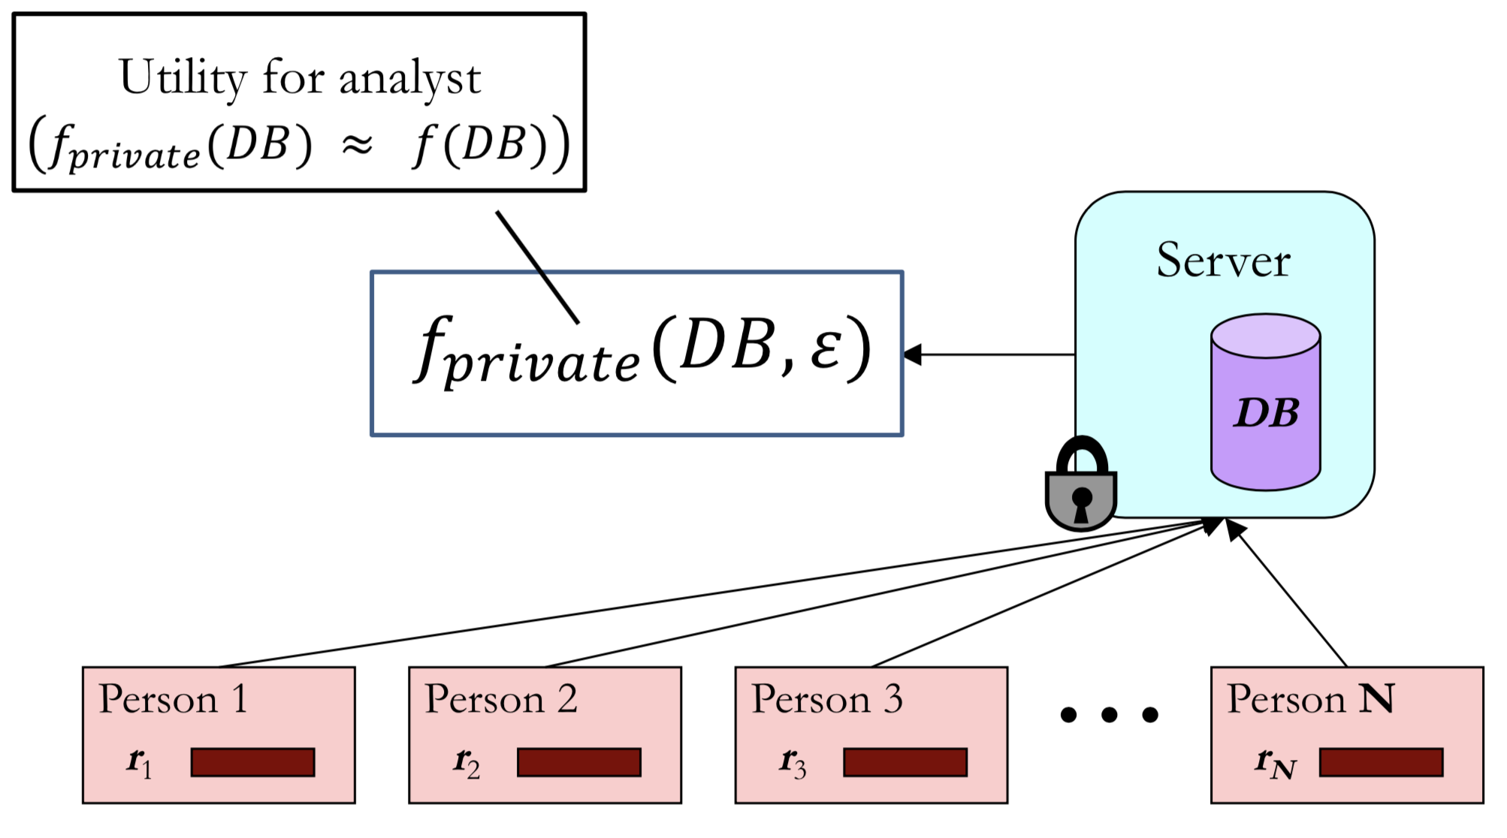
…and data utility

Slide 21
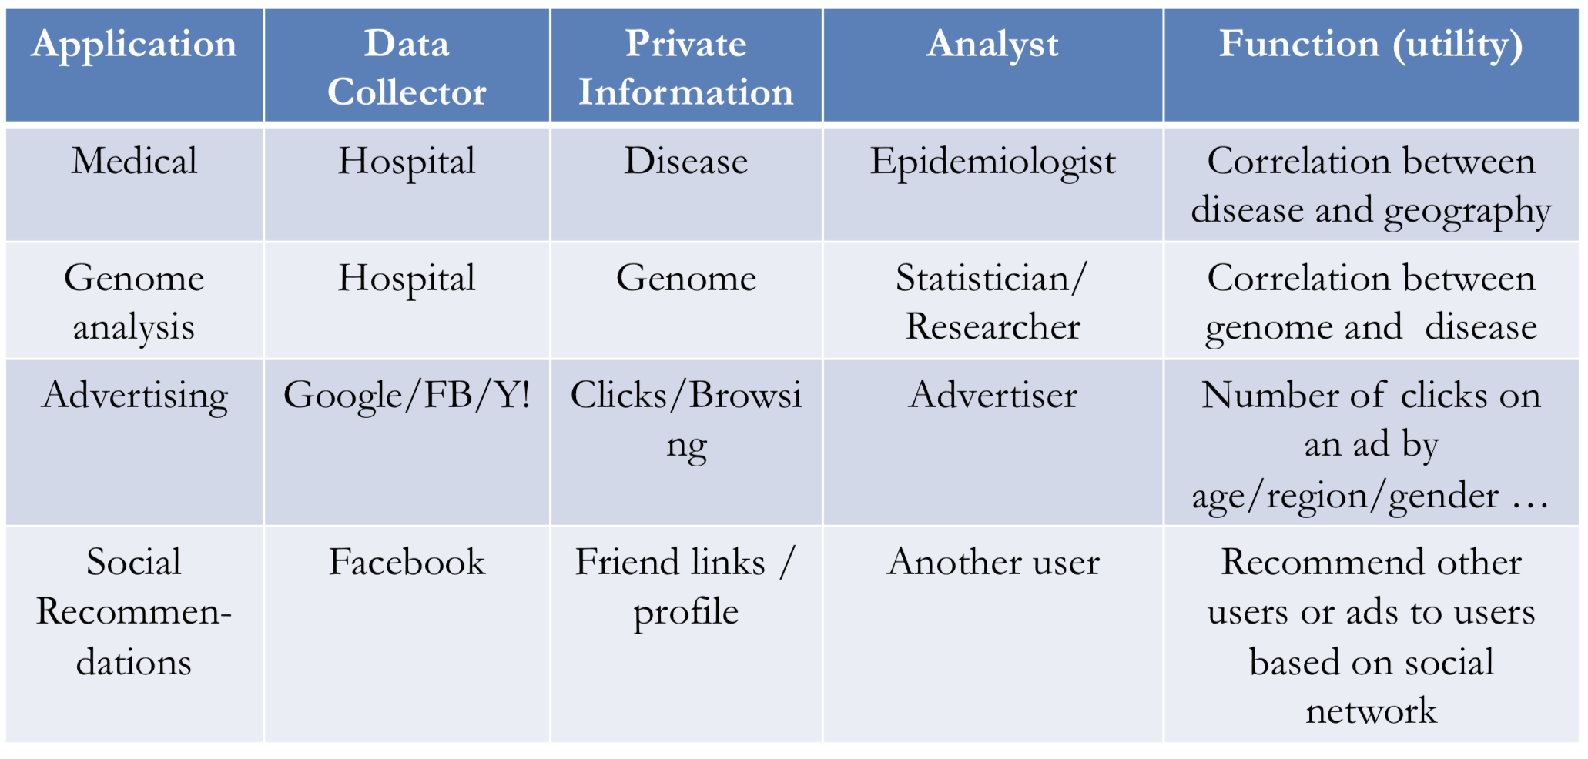
Example Applications

Slide 22
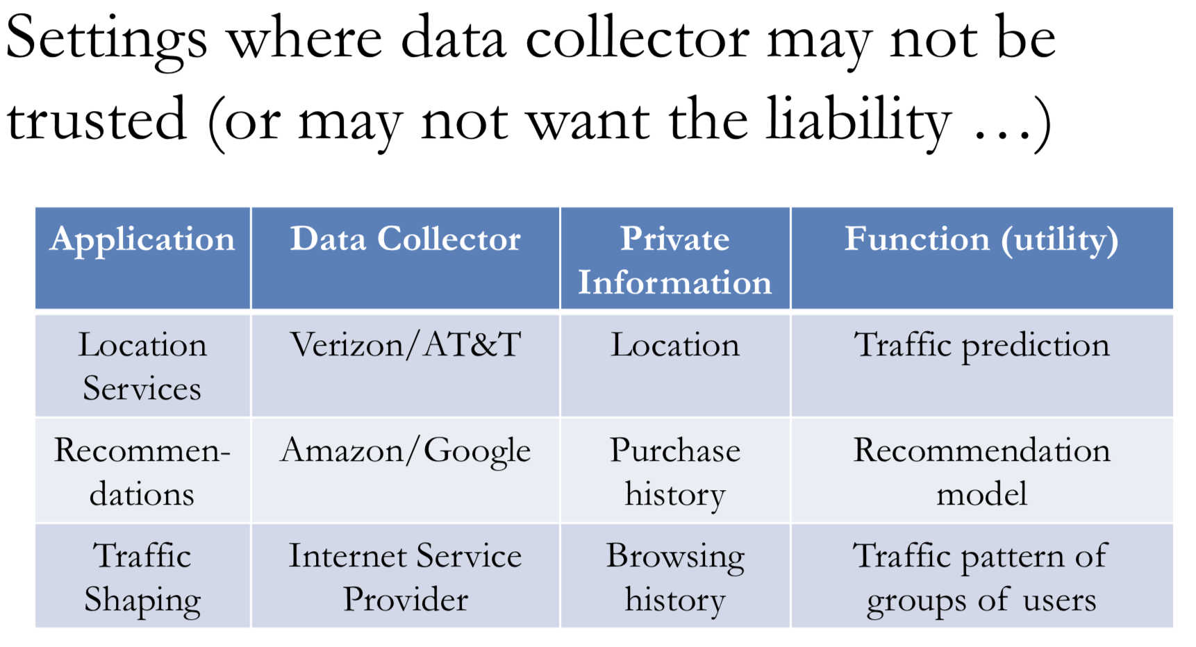

Slide 23
Statistical Database Privacy is not…
Encryption:
Alice sends a message to Bob such that Trudy (attacker) does not learn the message. Bob should get the correct message ...
Computation on Encrypted Data:
Alice stores encrypted data on a server controlled by Bob (attacker).
Server returns correct query answers to Alice, without Bob learning anything about the data.
Instead, statistical database privacy:
Bob (attacker) can access a database
Bob must learn aggregate statistics, but
Bob must not learn new information about individuals in database.

Slide 24
Statistical Database Privacy is not…
Secure Multiparty Computation:
A set of agents each having a private input xi ... - ... Want to compute a function f(x1, x2, ..., xk) - Each agent can learn the true answer, but must learn no other information than what can be inferred from their private input and the answer.
Instead, statistical database privacy:
Bob is allowed to learn aggregate properties of the database
Function output must not disclose individual inputs.

Slide 25
Statistical Database Privacy is not…
Access Control:
A set of agents want to access a set of resources (could be files or records in a database)
Access control rules specify who is allowed to access (or not access) certain resources.
‘Not access’ usually means no information must be disclosed
Instead, statistical database privacy:
A single database and a single agent
Want to release aggregate statistics about a set of records without allowing access to individual records

Slide 26
Issues of Privacy
In todays cloud context a number of privacy problems arise:
Encryption when communicating data across a unsecure channel
Secure Multiparty Computation when different parties want to compute on a function on their private data without using a centralized third party
Computing on encrypted data when one wants to use an unsecure cloud for computation
Access control when different users own different parts of the data
Statistical database privacy: Quantifying (and bounding) the amount of information disclosed about individual records by the output of a valid computation.

Slide 27
Defining Privacy
What is privacy?
Assume we have a privacy mechanism M(D)
Data is private if an unauthorized party can learn sensitive information about any individual in D
…which they could not have learnt without access to M(D)
E.g., learn data about Alice info that they would not know if Alice was not in dataset

Slide 28
Summary
Security is not through obscurity: We must assume attacker may know algorithm and model parameters
In practice, a little reverse-engineering can help ensure this is feasible (see later slides)
Statistical database privacy is the problem of releasing aggregates while not disclosing individual records
The problem is distinct from encryption, secure computation and access control.
Defining privacy is non-trivial – Desiderata include resilience to background knowledge and composition and closure under postprocessing.

Slide 29
Differential Privacy

Slide 30
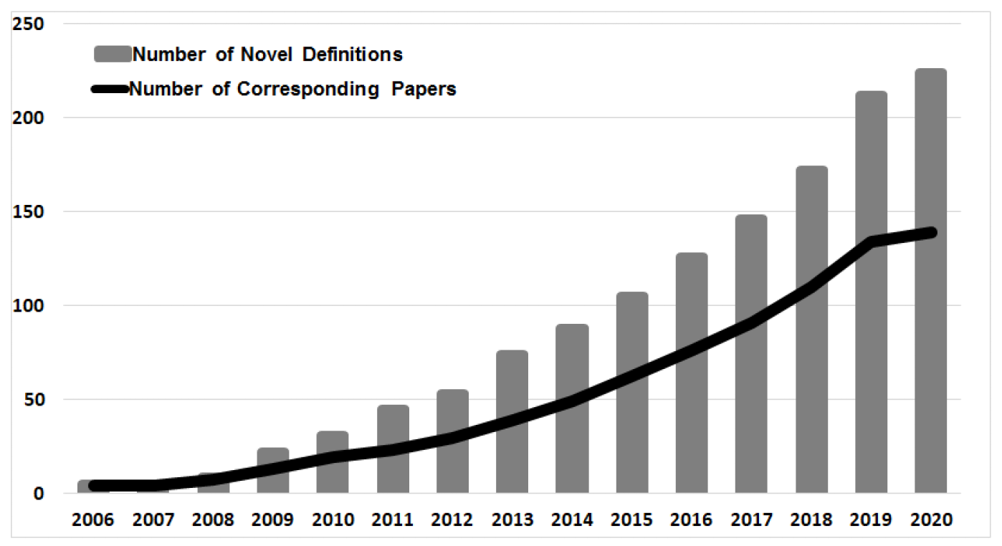
Many Ways To Define Data Privacy

Slide 31
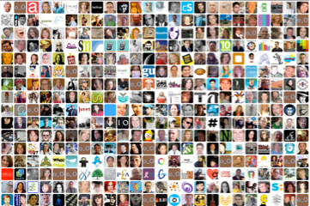

A Privacy desiderata
Data
Collected
Real World
Computation
Output
Every output almost the same with or without my data
≈
=
+
Notes:
Limit the increased risk to an individual incurred by joining (or leaving) a database
Output based on the database is almost equally likely whether or not an individual’s data is part of the database.
From privacy standpoint, may want it to be the same. From utility standpoint, want it to be different.
A privacy guarantee that limits risk incurred by joining the database encourages participation in the dataset.

Slide 32
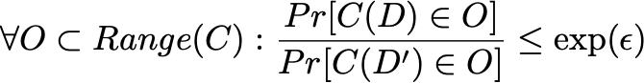
Defining Differential Privacy
[Dwork, McSherry, Nissim, Smith 2006]
Datasets D and D’ are neighbors if they differ in one person’s data
A computation C is ε-differentially private if for all neighbors D and D’: distribution of C(D) is nearly the same as C(D’)
probability over random coin tosses of the computation
Notes:
\forall D, D', \text{and } \forall O \in Range(C): \\
Pr[C(D) \in O] \leq \exp(\epsilon) Pr[C(D') \in O]
by now, family of definitions
focus is on the mechanism, not on the output, unlike in other notions

Slide 33
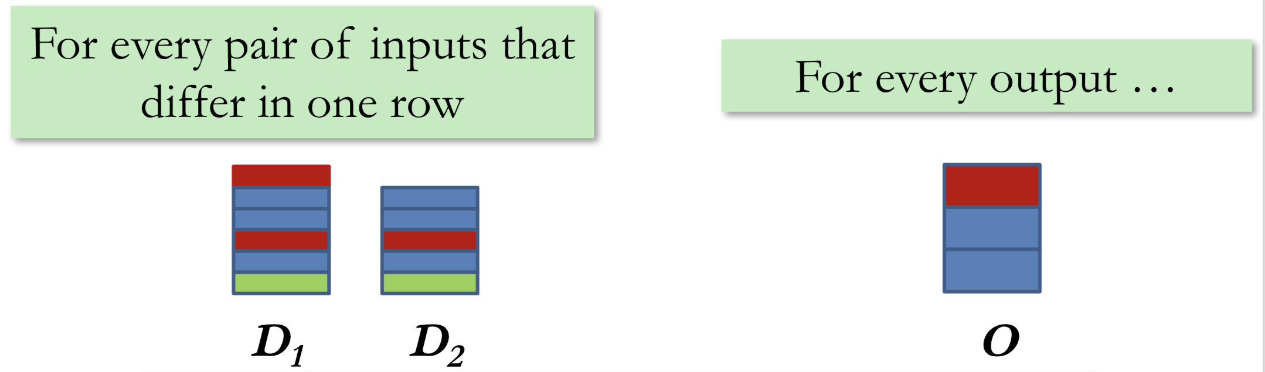
We should not distinguish between D1 and D2 (adding or removing our data)
Must be true for ALL data to guarantee results for all users
Epsilon controls the tradeoff between data accuracy and privacy

Slide 34
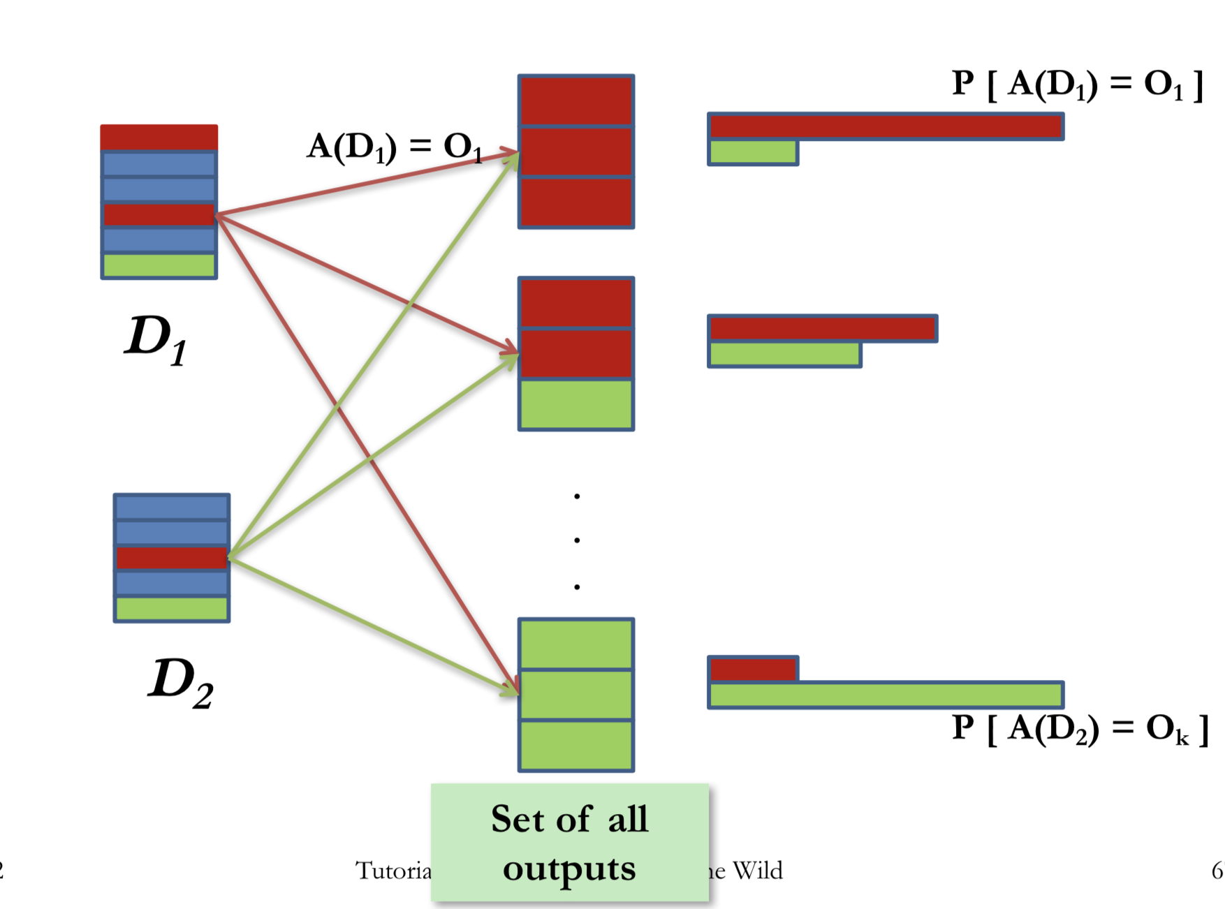
Why All Outputs?

Slide 35
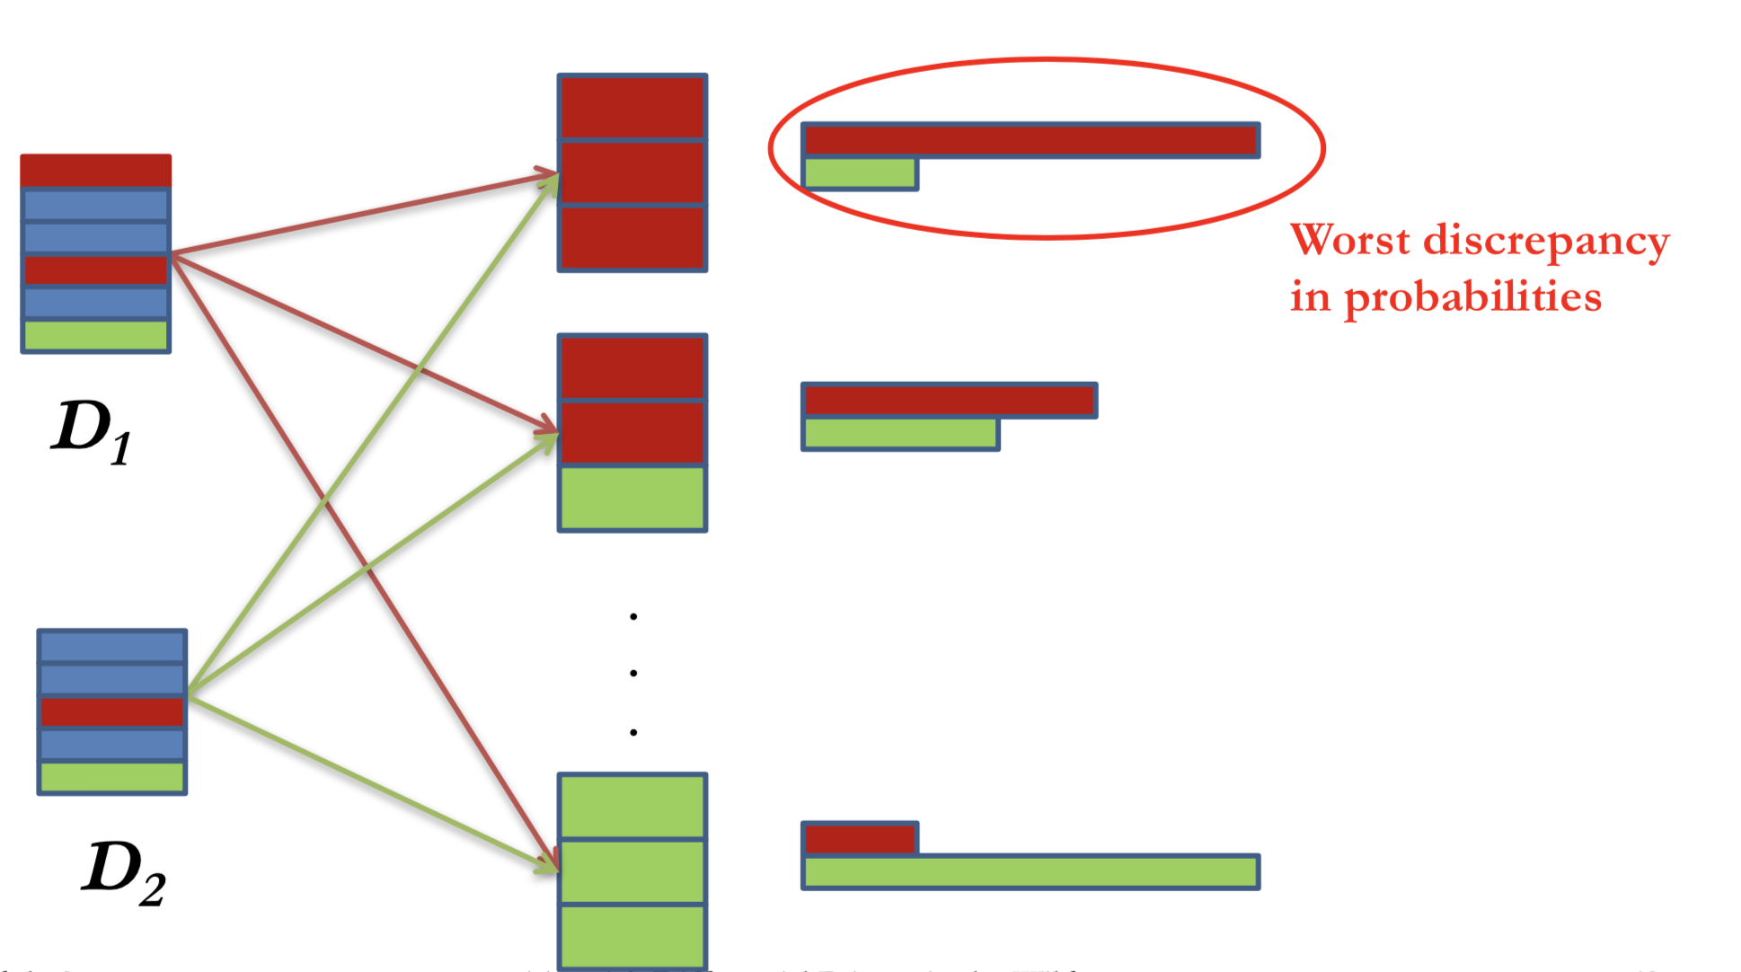
We should not be able to distinguish D1 and D2 no matter what is the output/query

Slide 36
General Privacy Principles
Add noise to answers such that:
Each answer does not leak too much information about the database.
Noisy answers are close to the original answers.

Slide 37
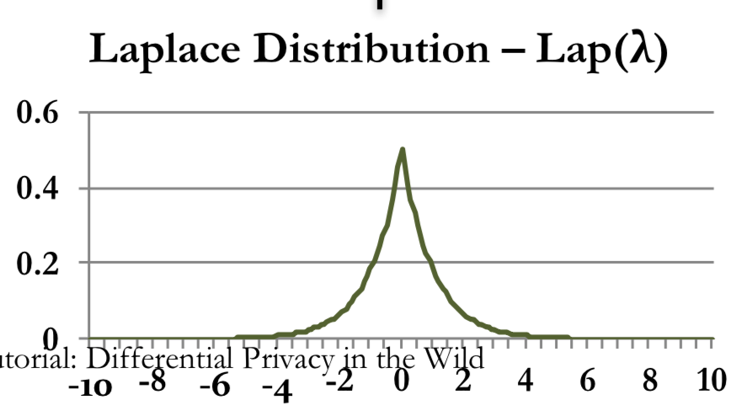
Laplace Differential Privacy
Sensitivity:
Smallest number, S(q) such that difference between queries q(D)-q(D’) <= S(q)
Thm: If sensitivity of the query is S, then the following guarantees ε-differential privacy. Lambda = S/ε: i.e., add noise to data with variance t= 2 (S/ε)² Noise distribution follows Laplace distribution

Slide 38
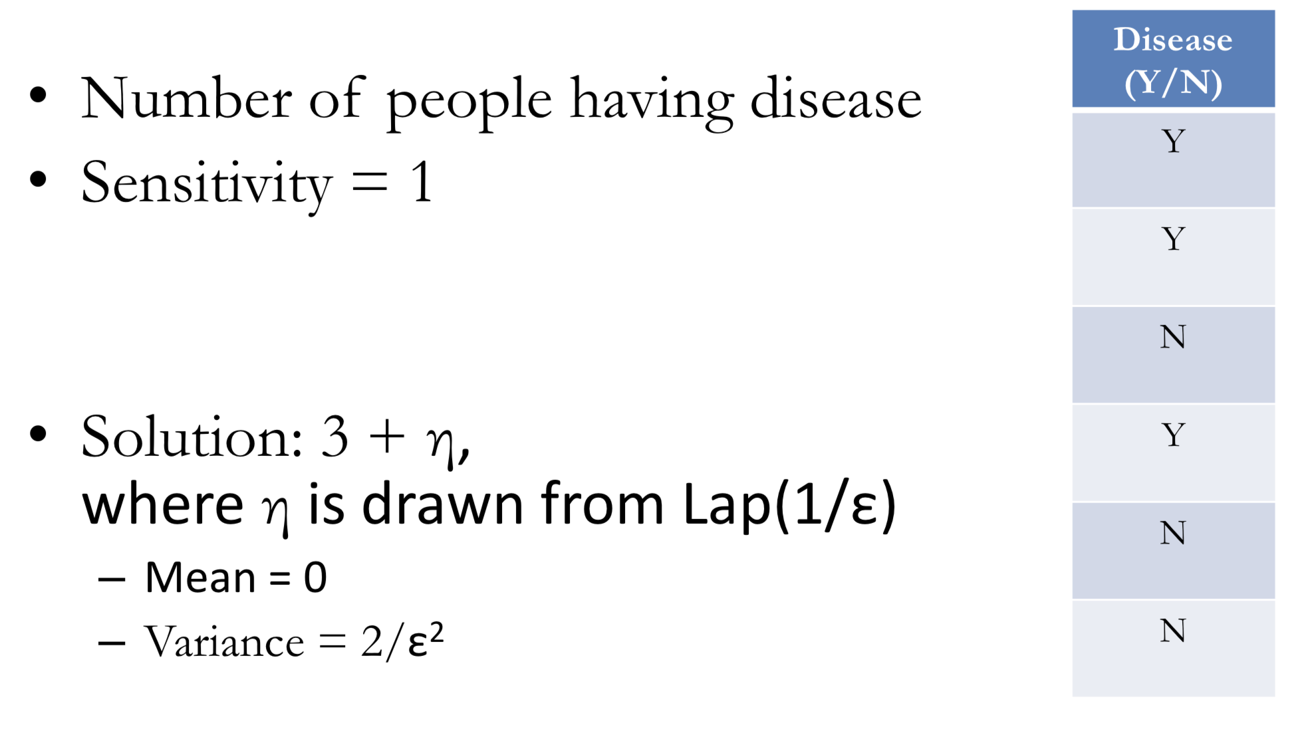
Sensitivity

Slide 39
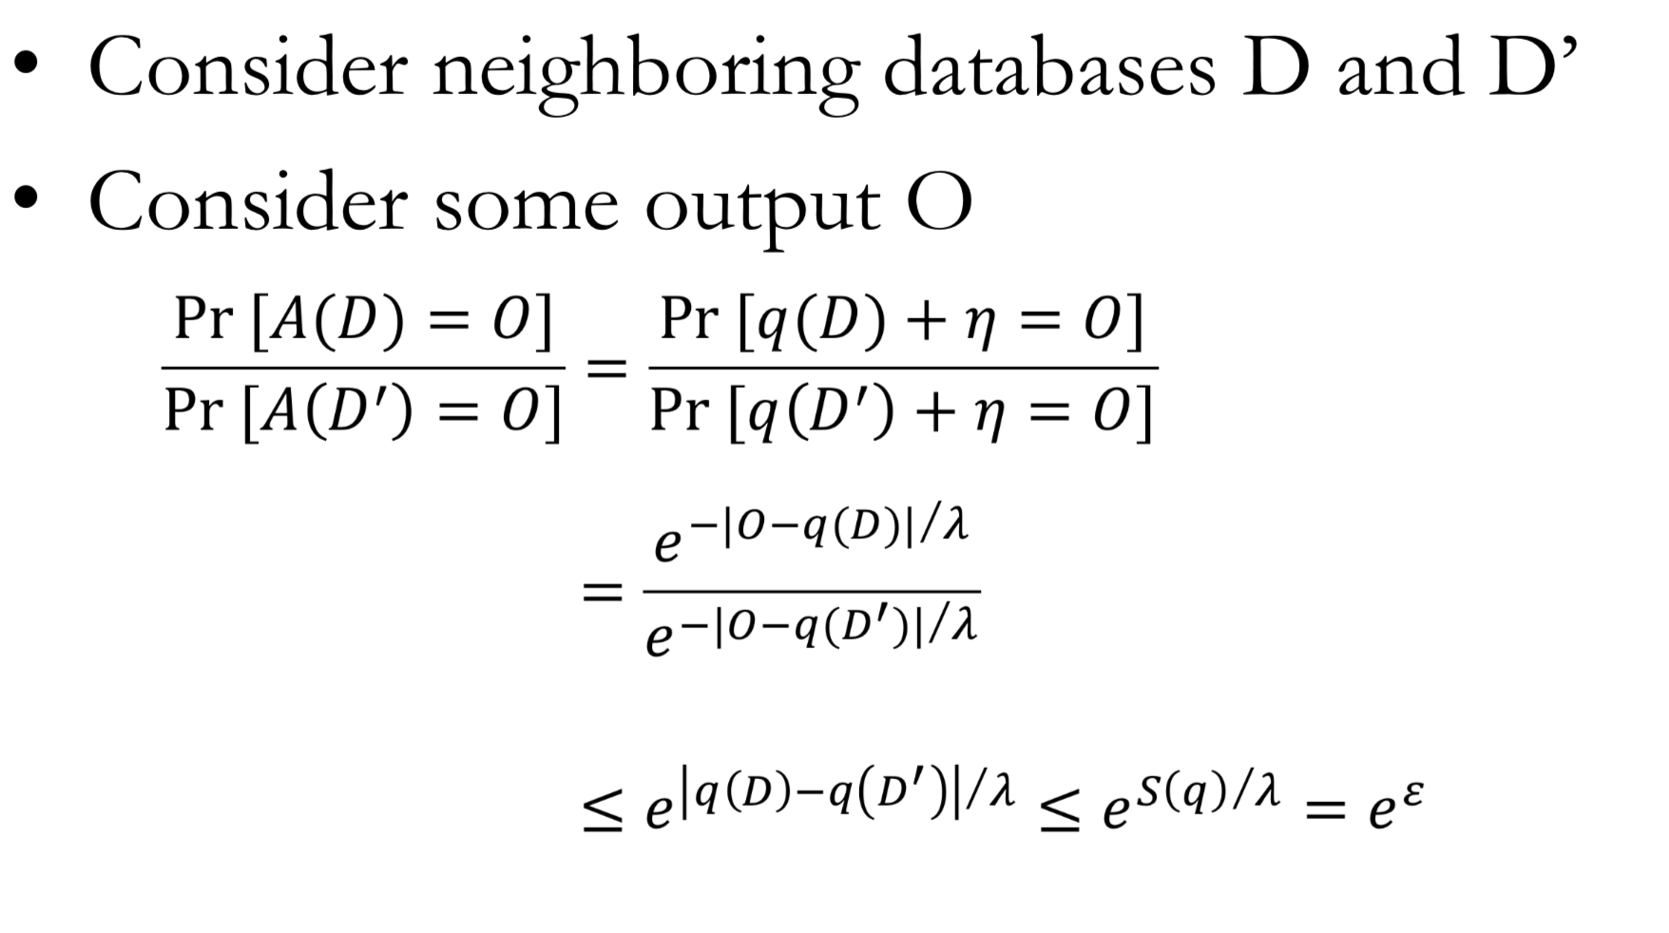
Privacy of Laplace Mechanism

Slide 40

differential privacy suits today’s data-driven world
Resilient against a powerful adversary
Applies to all data types
Composition, i.e., reasoning about privacy impact of multiple computations
two ε-DP computations result in 2ε-DP
post-processing is at no cost to privacy
Quantifies privacy and enables privacy / utility trade-offs

Slide 41
Achieving DP for statistical insights

Slide 42
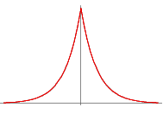
Achieving DP for mean salary
Algorithm
restrict range of salaries to [0, R];
compute true mean of n salaries;
add noise from Laplace distribution
with scale R/(εn);
Why does this preserve privacy?
Symmetrical noise introduces uncertainty
R/(εn) controls how much
Notes:
Double exponential, PDF: 0.5/b exp(-|x|/b)

Slide 43
Answering Multiple Queries
Rich science for repeated queries and how to use the privacy budget efficiently thanks to composition!

Slide 44
Utility
Range = [$0-$200k]
ε | n | error (95% confidence)
1 | 30 | 10%
1 | 300 | 1%
1 | 3,000 | 0.1%
Notes:
Pr[|\text{true mean} - \text{reported mean}| \geq \frac{R}{\epsilon n} \cdot \ln(\frac{1}{\delta})] \leq \delta

Slide 45
Utility
Range = [$0-$200k]
ε | n | error (95% confidence)
1 | 30 | 10%
1 | 300 | 1%
1 | 3,000 | 0.1%
5 | 6 | 10%
5 | 30 | 2%
5 | 60 | 1%

Slide 46


Lots can be done with DP
statistics: counts, median, histograms, boxplots, etc.
supervised & unsupervised ML: regression, classification, clustering, distribution learning, recommendations, deep learning
data and model publishing, including search logs, synthetic data
Randomization not under adversary’s control
Notes:
Because of the noise addition, DP algorithms work best when the number of records is large

Slide 47

DP for practice ?
works best for large # of data points
robustness (including to adversarial examples)
statistical validity
algorithm is public
enables making trade-offs between privacy and utility
Notes:
epsilon smoothly trades off between perfect privacy and exact disclosure
so DP provides a language for the debate between actually quantify privacy and its tradeoff with utility

Slide 48
Learning from sensitive data without collecting it

Slide 49
Innovating on the most sensitive data
Sensitive data
Risk of subpoenas, data breaches and data sharing
Don’t want to share
Don’t want to collect
How to enable innovation without collecting data?
Notes:
run a test in order to collect more people’s salaries
more people will be willing to share if there’s no hackable subpoenable database
Some data is so sensitive that individuals are hesitant to give it up, even with the promise of eventual deletion, due to risk of subpoenaes, data breaches, mis-use by collector

Slide 50


Approach: Ensure Local DP
Privatized
Privatize
Data
Privatize data before it reaches the company
Differential privacy: data received by collector does not change much regardless of user’s true data

Slide 51
is local DP that preserves utility achievable?
it’s harder to do than in the trusted curator setting
higher computation & communication cost, more data is needed
but it’s possible!

Slide 52





Learning a sensitive bit
Company goal: Estimate fraction of people happy with their current jobs
Worker’s goal: have company learn accurate information without trusting the company with their answer
Worker’s actions
say the truth
Randomized
Response
heads
flip a coin, in private
tails
say “YES” or “NO” at random
Notes:
Trade-off: epsilon vs number of people for 1% error with 95% probability
expected number of yes answers = 1/4* total number of answers + 1/2* true yes
true yes = 2*expected number of yes -1/2*total number of answers
with enough data

Slide 53

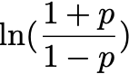
Learning a sensitive bit
Privacy
Worker’s actions
heads
say the truth
flip a coin, in private
tails
say “YES” or “NO” at random
(ln 3)- differential privacy
coin with bias p towards heads gives differential privacy

Slide 54

Learning a sensitive bit utility
Worker’s actions
heads
say the truth
flip a coin, in private
tails
$$⋅$$
say “YES” or “NO” at random
Company de-noises results:
E[# YES responses] = 0.25n+0.5⋅#true YES % people happy = 2⋅% YES responses - 0.5
#people↑, p↑, accuracy↑
Learned stats it couldn’t obtain without DP
Notes:
expected number of yes answers = 1/4* total number of answers + 1/2* true yes
true yes = 2*expected number of yes -1/2*total number of answers
with enough data

Slide 55
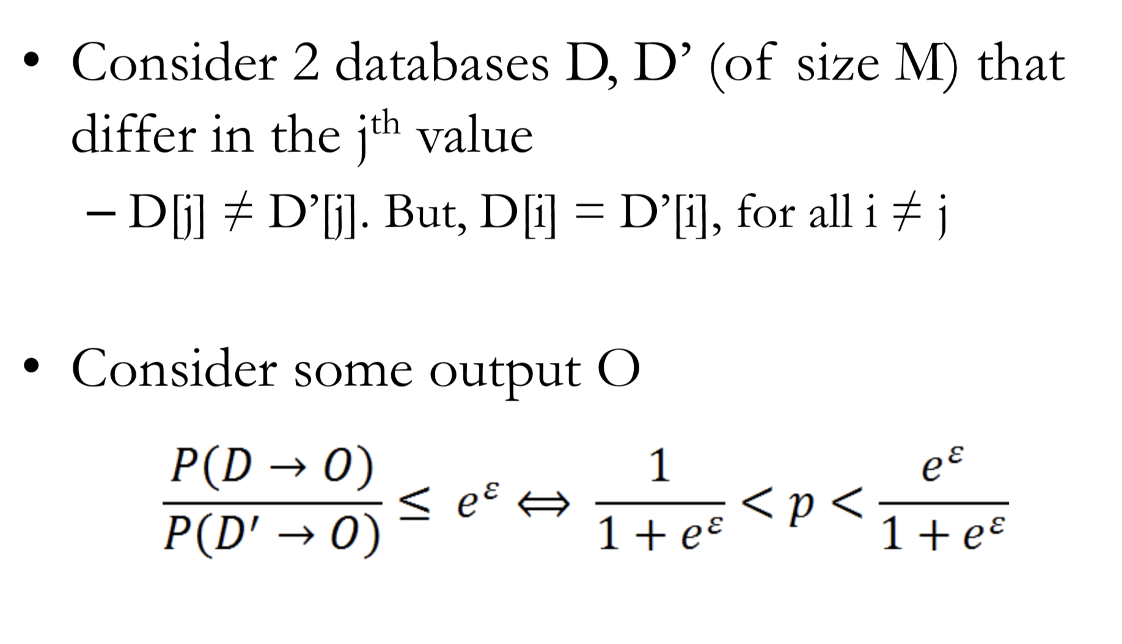
This Method Ensures Differential Privacy!

Slide 56
Learning from non-binary data
Learning from binary sensitive data without collecting it
What about non-binary data?

Slide 57
Learning the distribution of salaries w/ local DP
Salary: 65k
…
50-60k
60-70k
70-80k
80-90k
90-100k
…
…
0
1
0
0
0
…

Slide 58

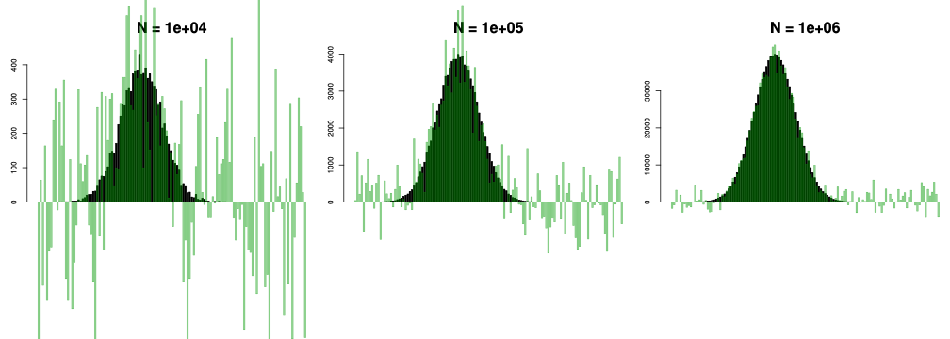
Utility: Learning an unknown distribution
ε=ln 3
true distribution
estimate of distribution

Slide 59
Aside: Laplace Mechanism vs Randomized Response
Privacy
Provide the same ε-differential privacy guarantee
Laplace mechanism assumes data collected is trusted
Randomized Response does not require data collected to be trusted
Also called a Local Algorithm, since each record is perturbed

Slide 60
Aside: Laplace Mechanism vs Randomized Response
Utility
Suppose a database with N records where μ*N records have disease = Y.
Query: #rows with Disease = Y
Std dev of Laplace mechanism answer: O(1/ε)
Std dev of Randomized Response answer: O(√N)

Slide 61
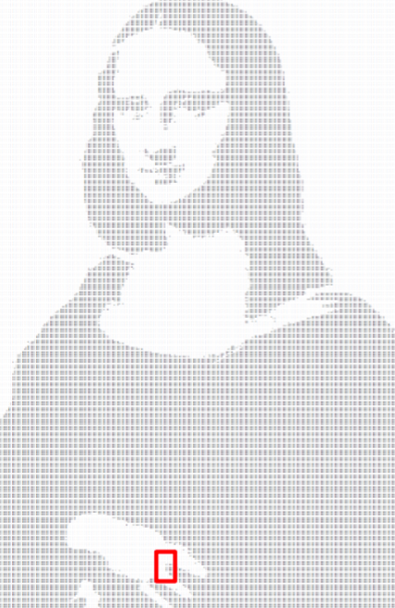
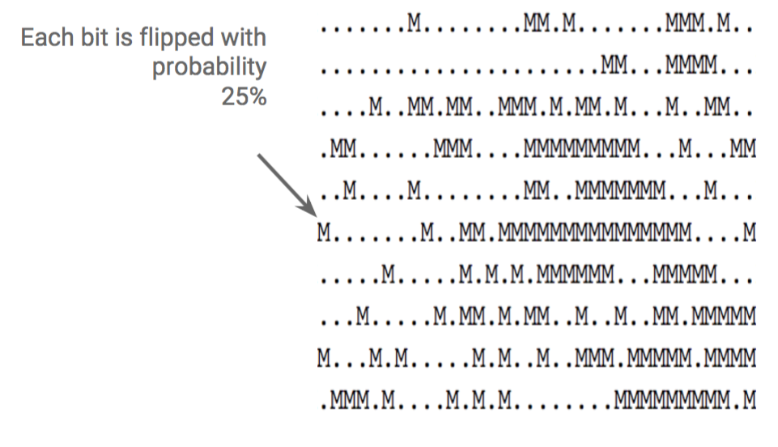

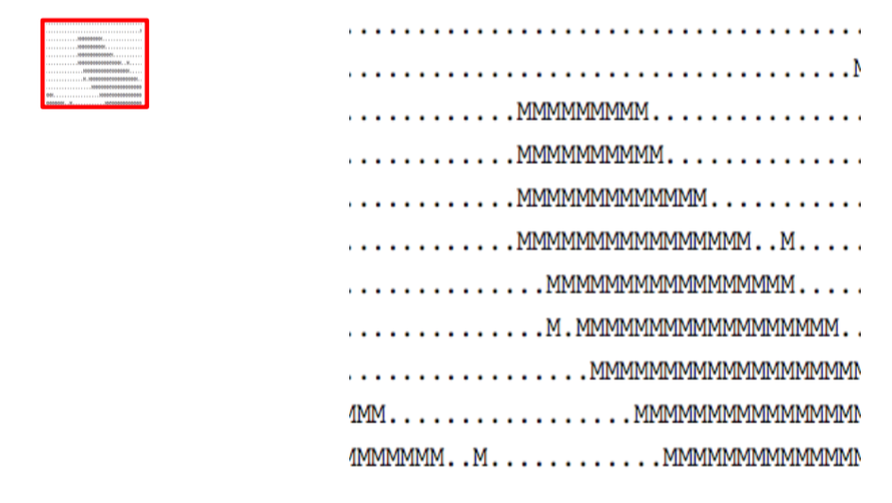
A Metaphor
for scaling it up
Each person
Randomized response
Slide: I. Mironov

Slide 62
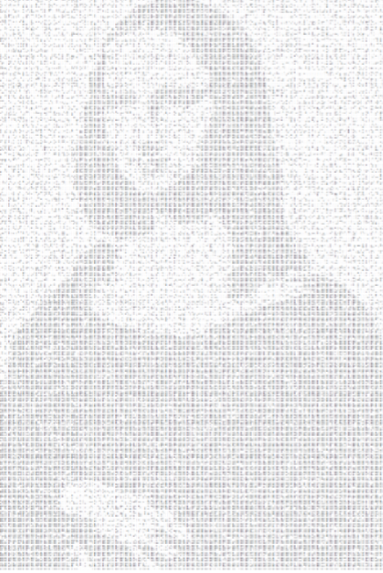
Big picture remains
Slide: I. Mironov

Slide 63


Rappor in Chrome
https://github.com/google/rappor
Chrome’s goal: identify unwanted software hijacking user home pages without collecting the home pages
Use Bloom filter to represent home pages
Run randomized response on it
Avoid creating a new persistent identifier via a two-level randomized response
Google: run a smarter de-noising procedure
100+ use cases

Slide 64

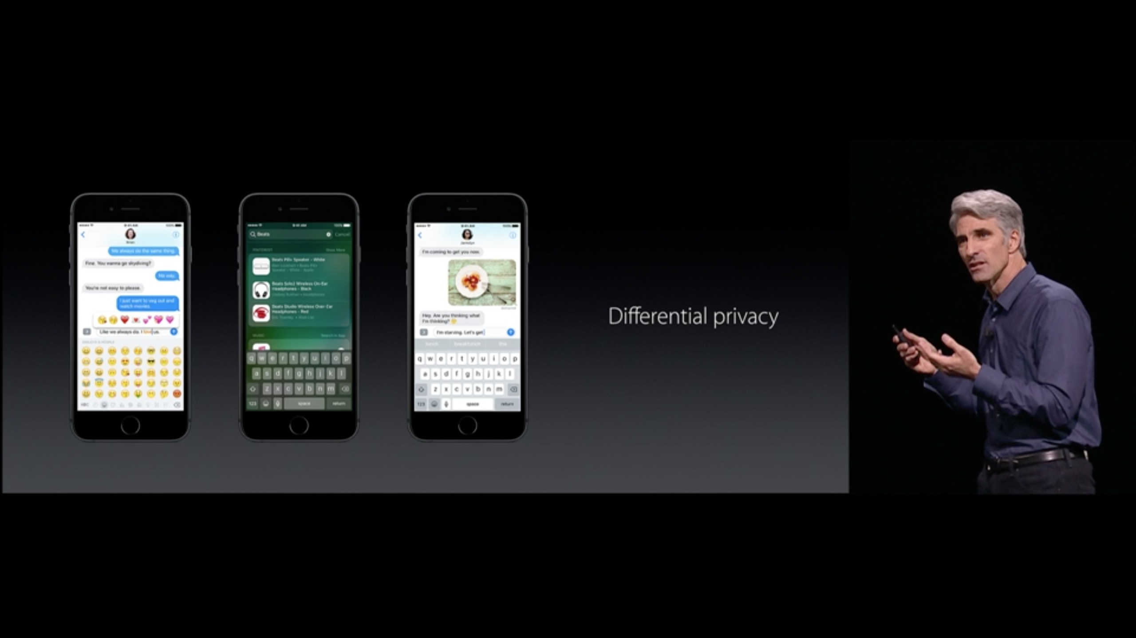

DP as an enabler for learning from sensitive data
Utility — not perfect but better than not having data at all.

Slide 65
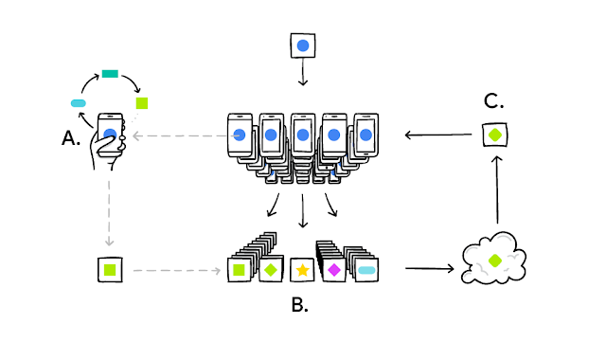
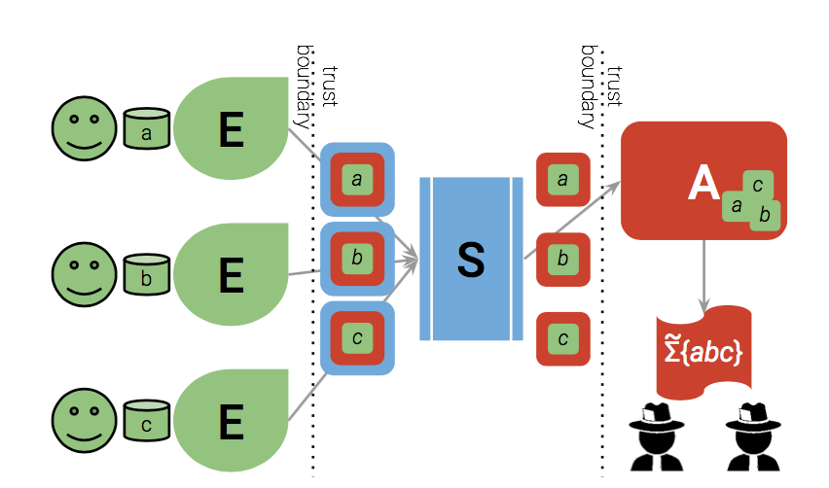
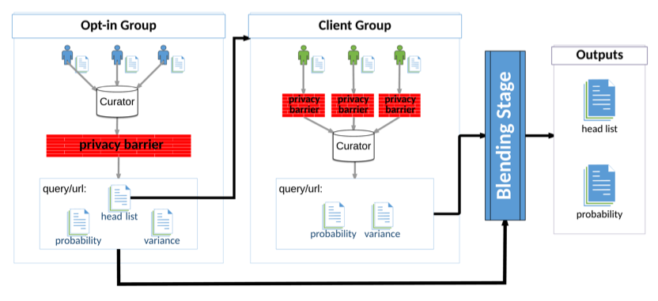
local* Differential privacy Active area of research
Instance 1
Instance 2*
Instance 2
Instance 2
Instance 3
Client model update
Instance 4
Draw
Discard
Instance 3
Instance 4
Pihur et al
McMahan et al
Bittau et al
Avent et al

Slide 66
Other methods: Bounding Queries
In order to ensure utility, a statistical database must leak some information about each individual
We can only hope to bound the amount of disclosure
Hence, there is a limit on number of queries that can be answered

Slide 67
Dinur Nissim Result
“20 questions”
n log(n)^2 queries reconstruct database of size n
Even with sqrt(n) noise added!
However, sequentially accessing data from K ε -differential private models ensures ε differential outcome with ε = ε₁ + ε₂ + ε₃ + … (reduction in privacy, but bounded)

Slide 70
Recall Kmean Algorithm

Slide 78
Summary
Differentially private algorithms ensure an attacker can’t infer the presence or absence of a single record in the input based on any output.
Building blocks – Laplace, exponential mechanism and randomized response
Composition rules help build complex algorithms using building blocks

Slide 79
Privacy for High Dimensional Data
While this works well in tabulated data, this may not generalize well to untabulated data
Text
Images
…
How much of a problem is this?
We demonstrate issue of model inversion
How do we address these issues?

Slide 80
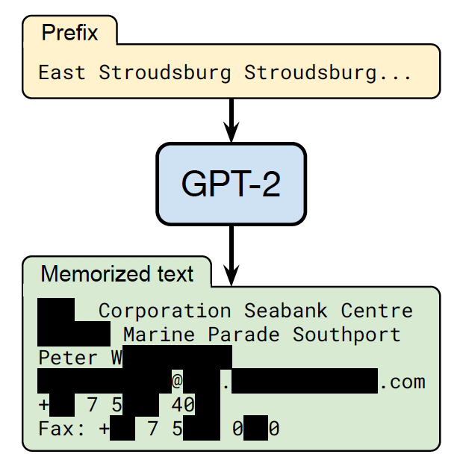
Text Model Inversion
Carlini et al., 2020

Slide 81
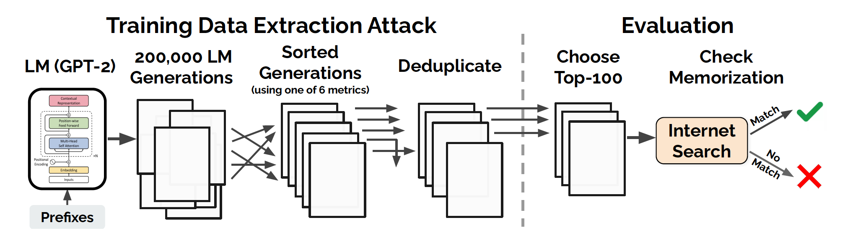

Slide 82
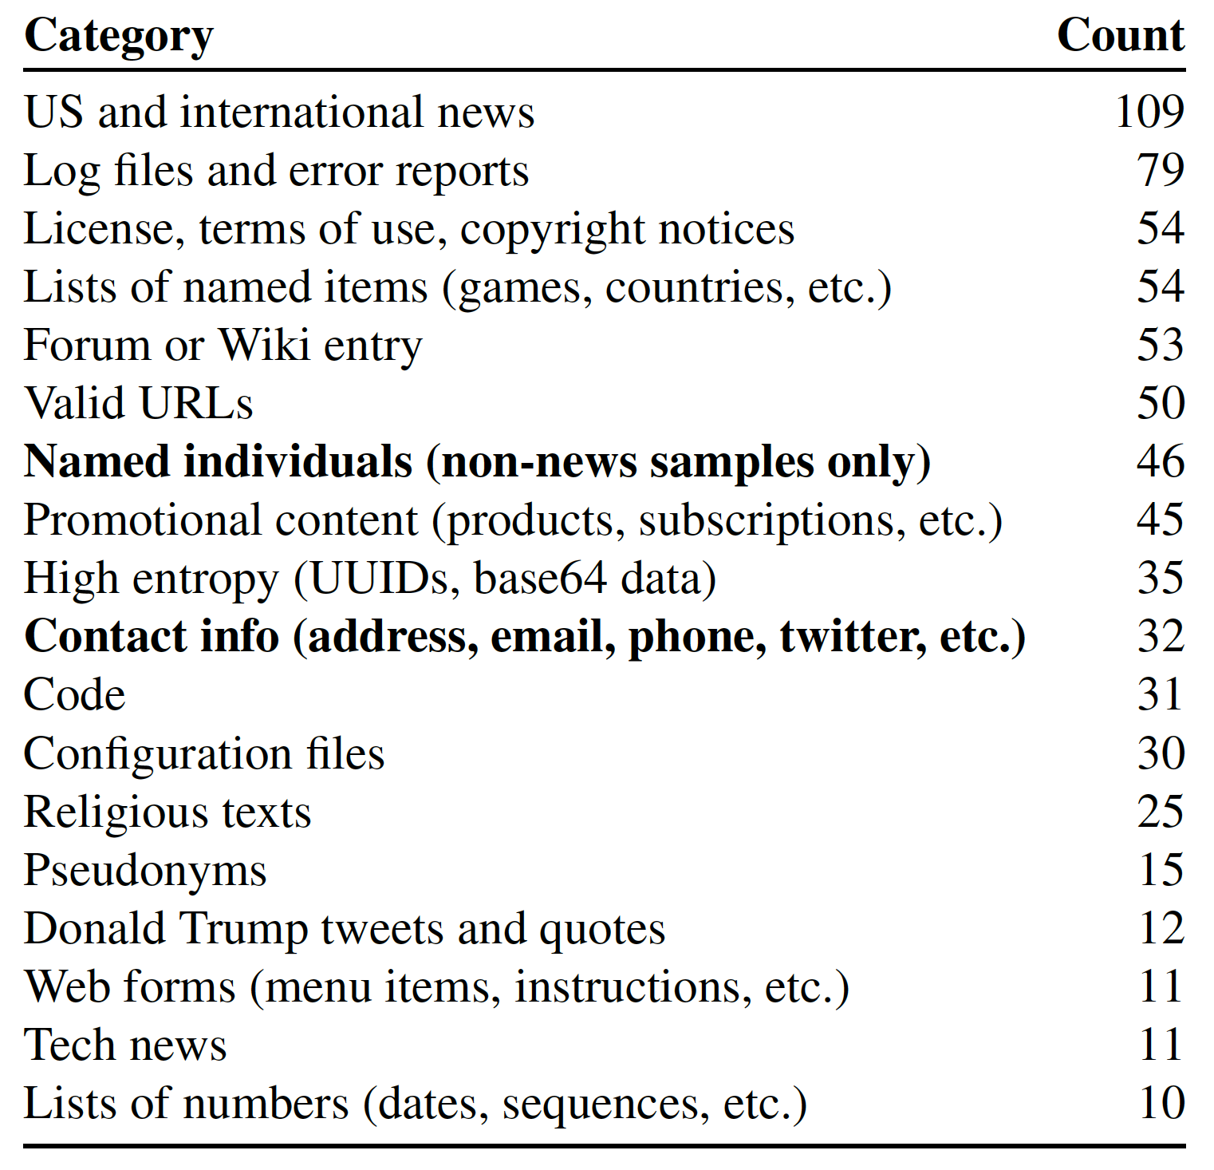
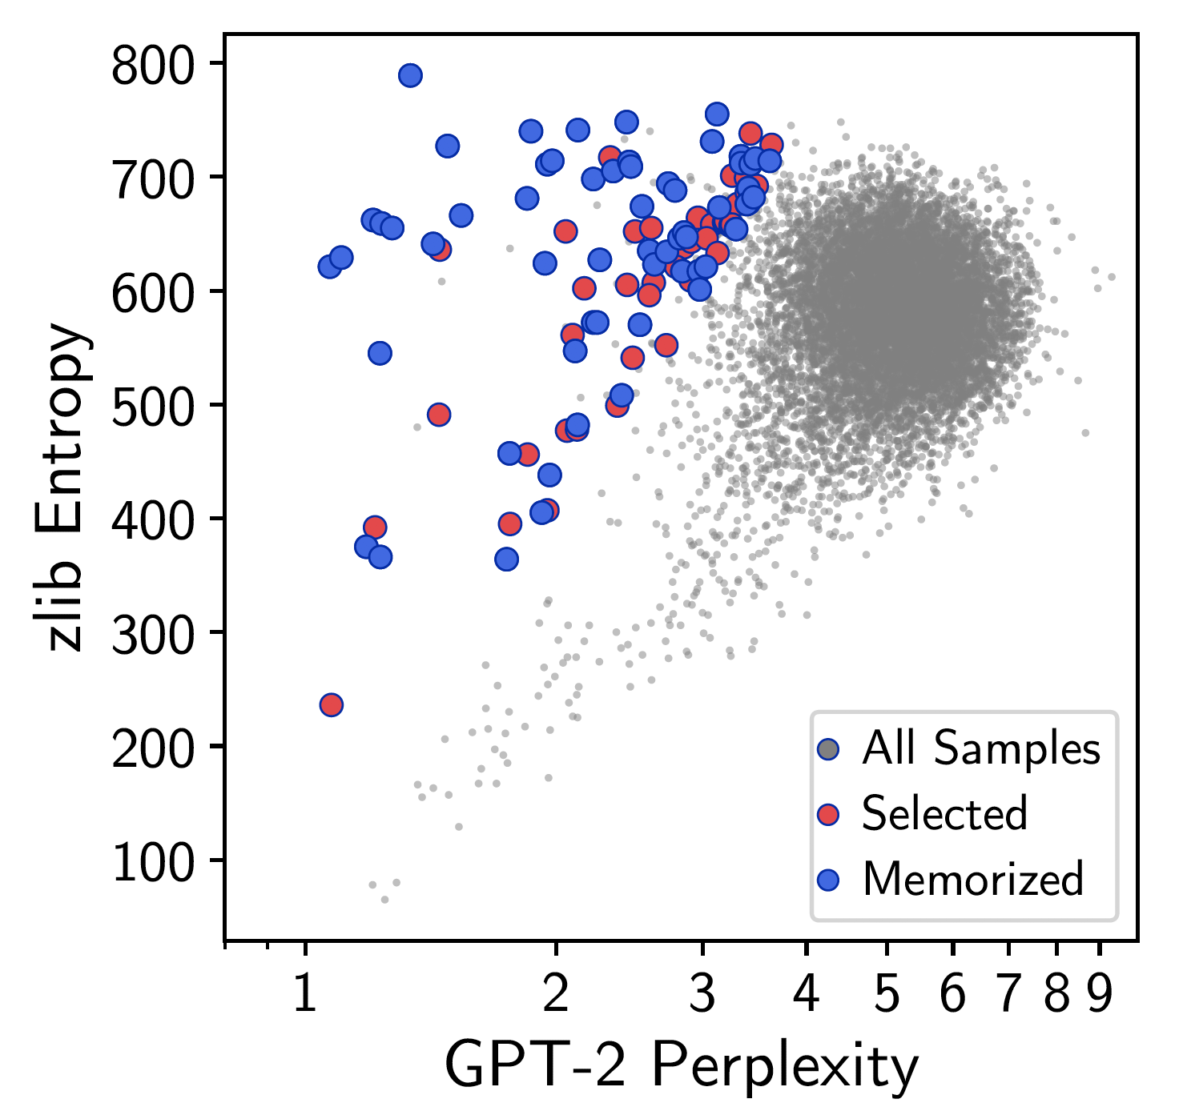

Slide 83
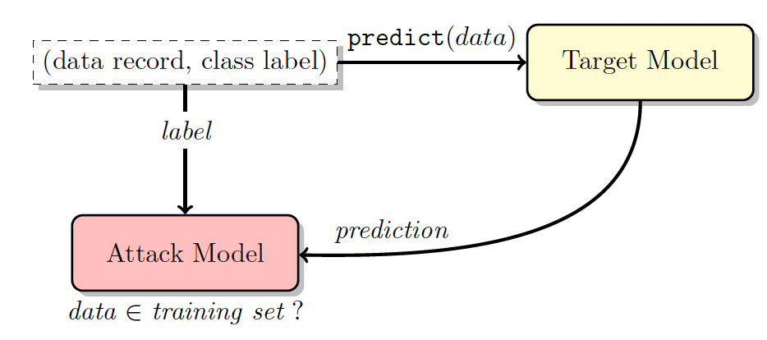
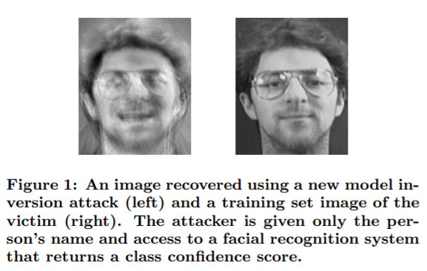
Model Inversion Attacks

Slide 84
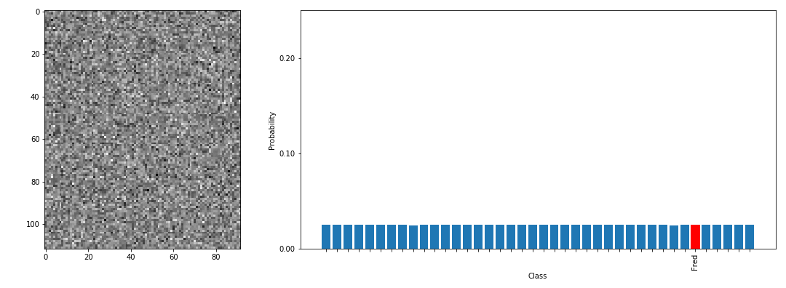
How it works in practice

Slide 85
Inversion Method
Start with random noise (perhaps a less naïve initial condition may work better?)
Model will give back confidence score
Adjust image fed into model until confidence score is maximized
This lets us know what the model really “sees” or “notices” in an image
But if data is memorized, this lets us determine training data!
This method, however is not optimal for diverse datasets (Shokri et al. 2017)

Slide 86
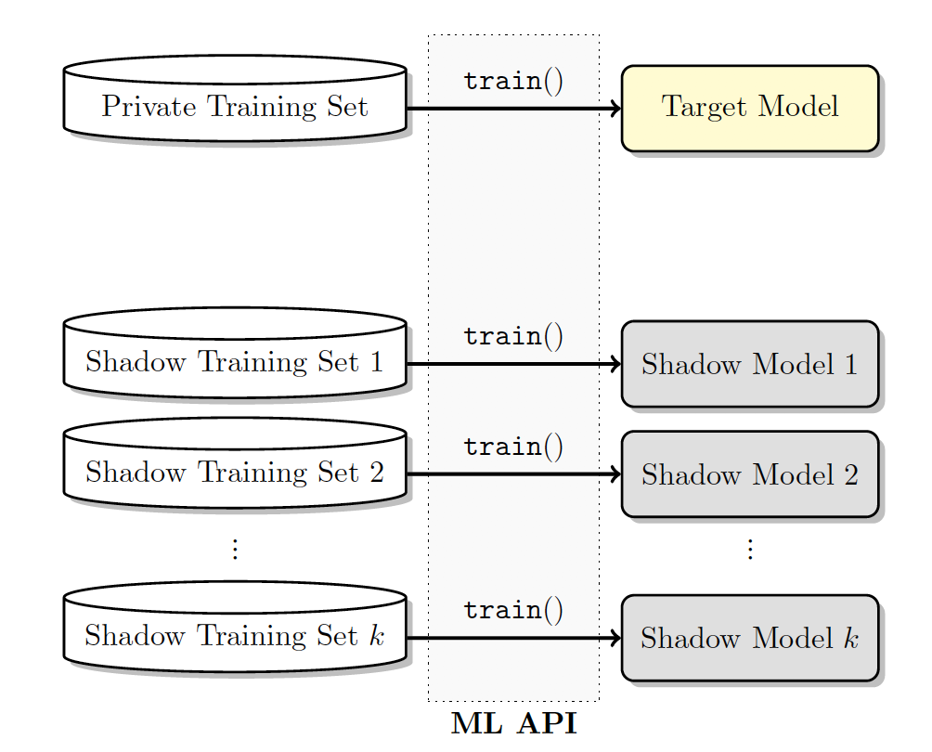
Success of Model Inversion Attacks
Membership inversion: is data in training dataset?
If medical diagnostic model, we could infer disease of patient
We train several “shadow” models with training data (trained alike to target model)
Attack will reveal if shadow model predicting on training data or not

Slide 87
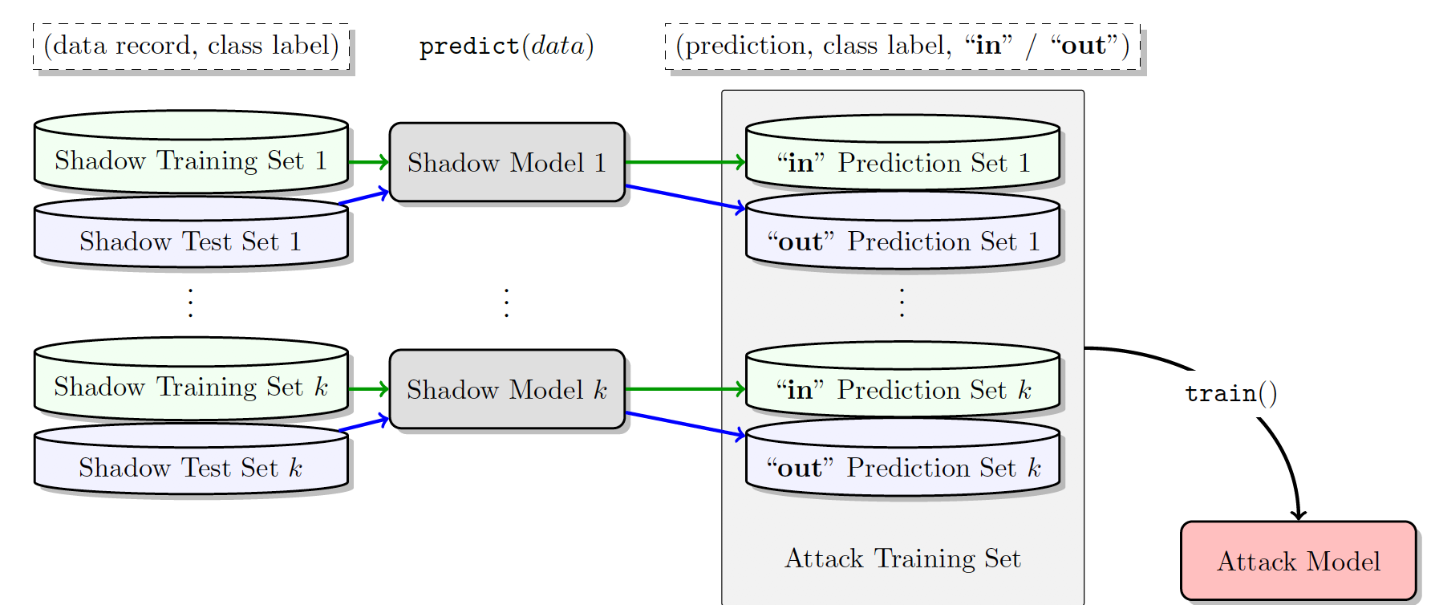
Determining if Data in Training Set

Slide 88
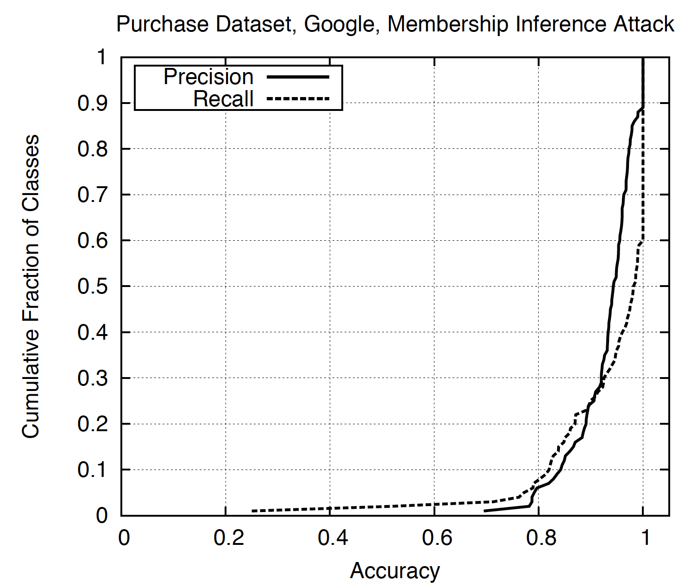
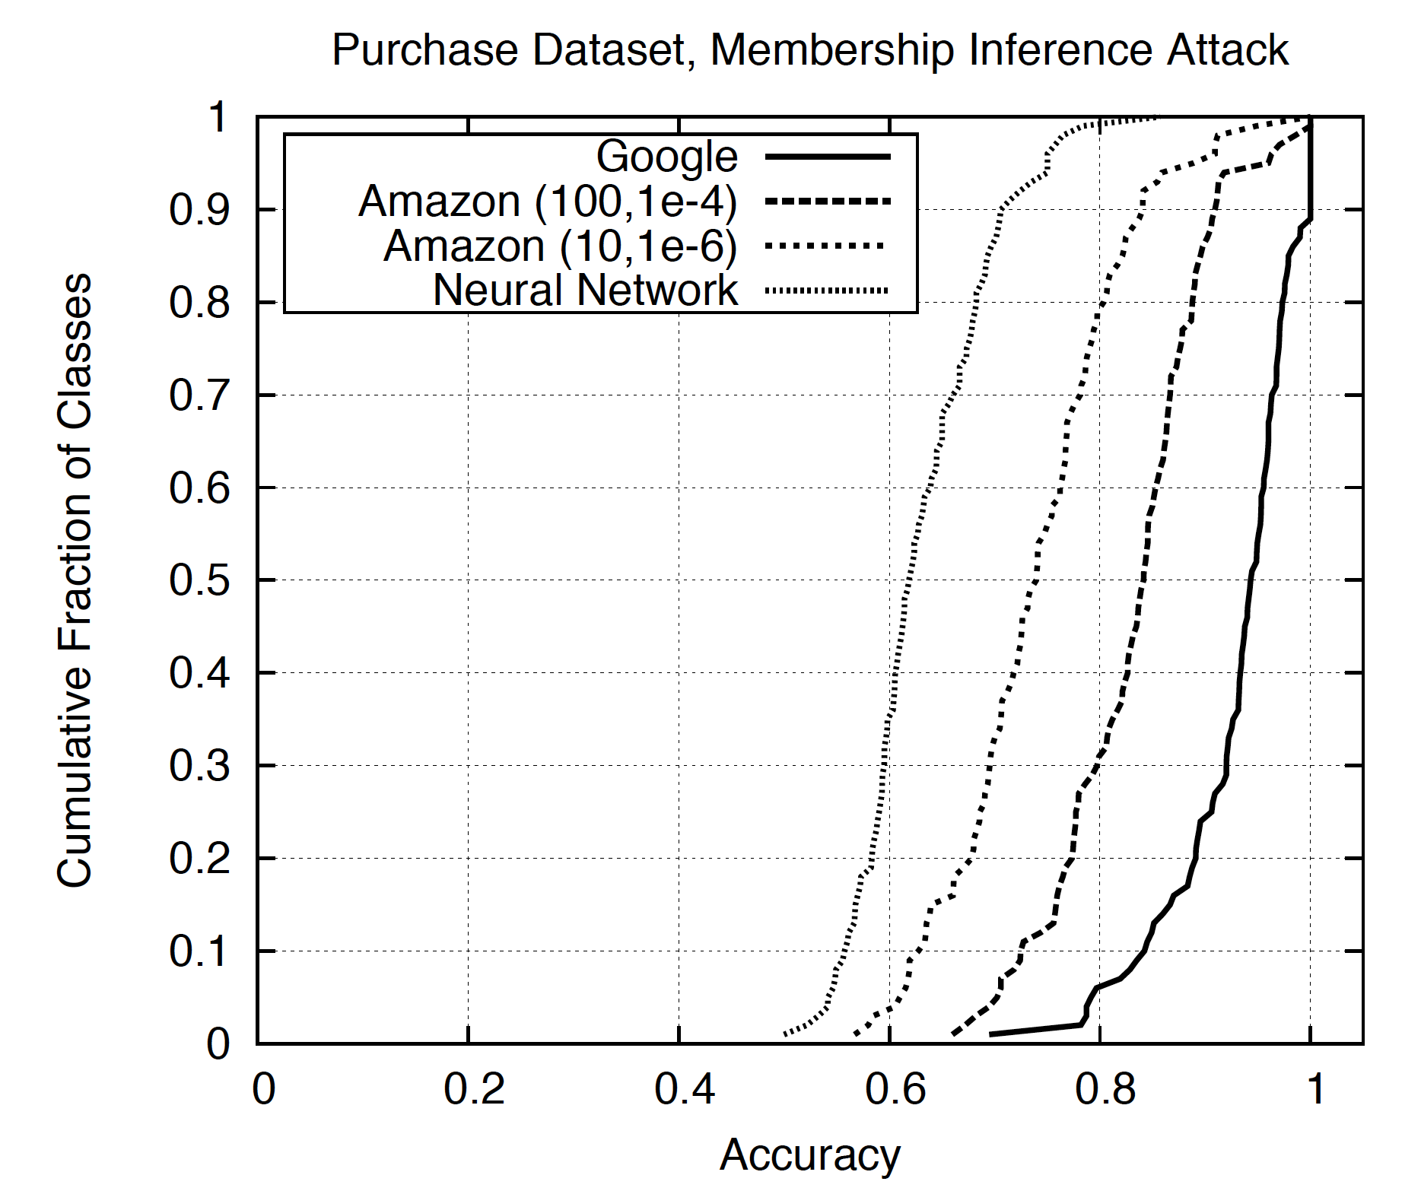
Attack Successfully Determines Training Data

Slide 89
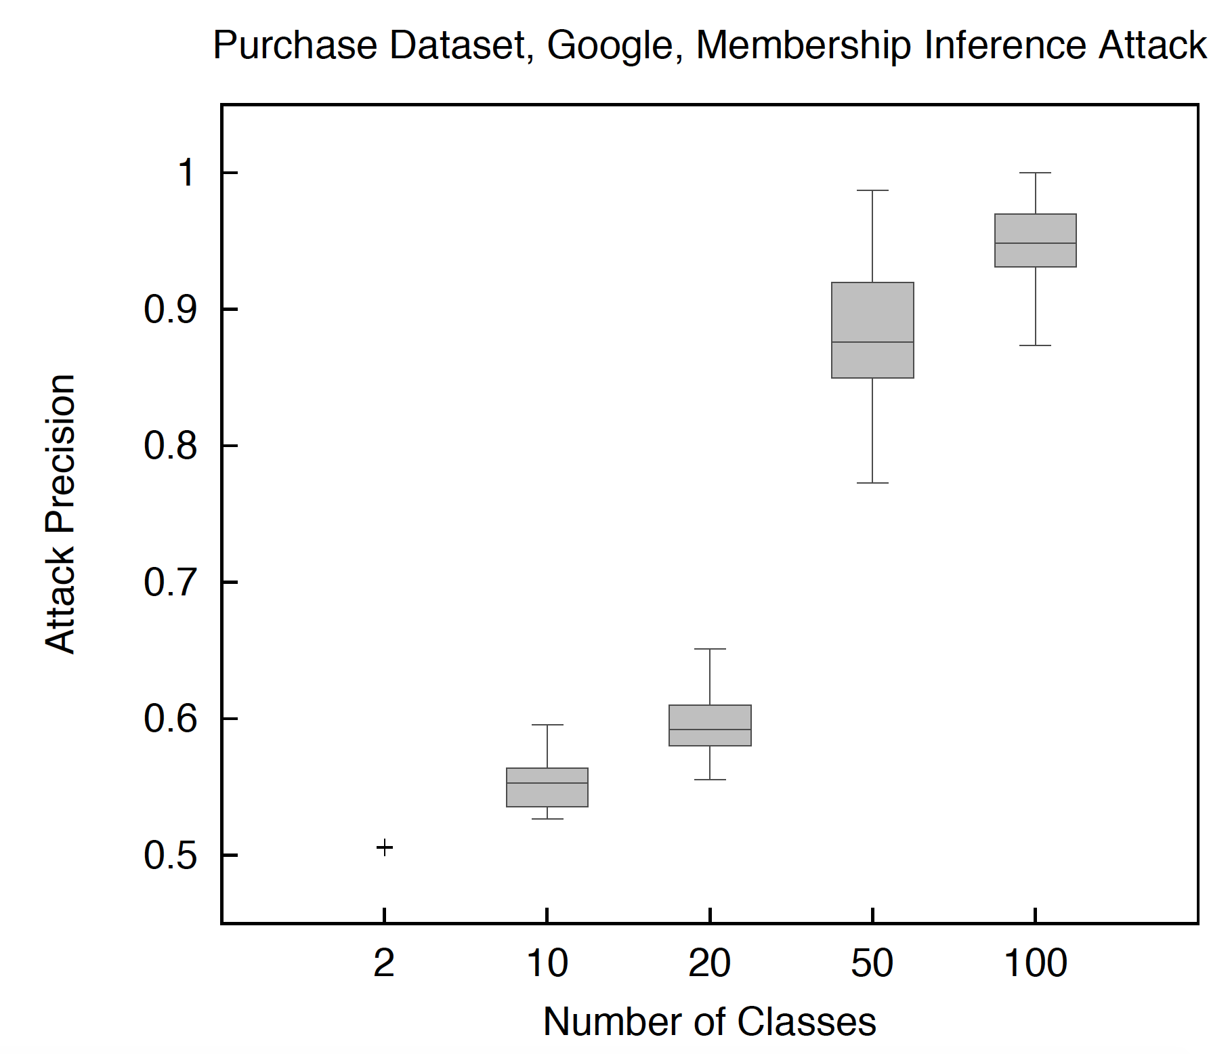
Success of Attack
Attacks are robust even if the attacker’s assumptions about the distribution of the target model’s training data are not very accurate.
Needs only “black box” access (does not need to know actual model architecture)
Works when there are many classes (homogenous data within a class)
Overfitting is therefore not the only factor for attack success!

Slide 90
Mitigating Model Inversion
Different types of model inversion:
Reconstructing training data versus detecting training data
Diversity of data in each class reduces training data reconstruction
Reducing training data detection
Naïve methods (e.g., don’t show confidence, or regularize model) are not good mitigation strategies
Data shift: if test, training data accuracies change, then attack is more successful
Make sure training data is more representative
Or apply domain adaptation, transfer learning (we will discuss this later) to ensure safety of training data
Overall, be very careful about data applied to training set, reduce access to it!

Slide 91
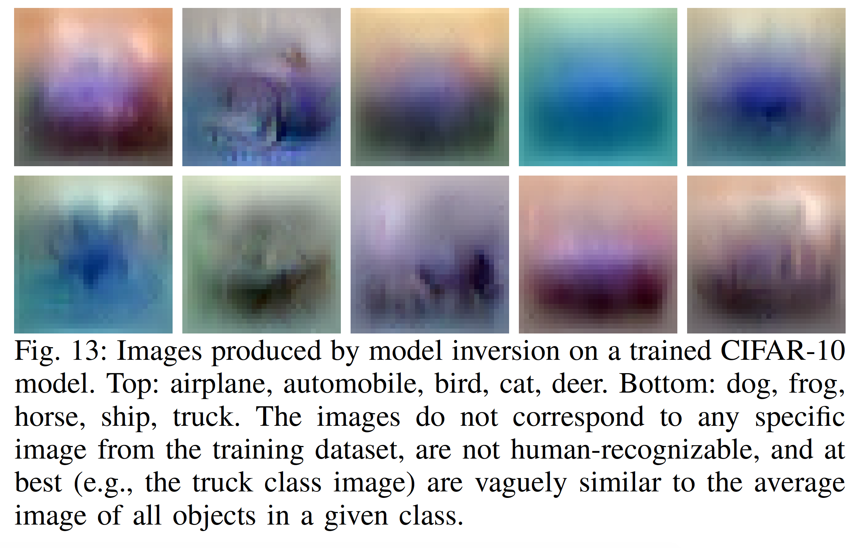
Training Data Reconstruction Not Successful for Diverse Classes
Shokri et al, 2017

Slide 92
Conclusion
Differential
Privacy
Share statistical insights
Privacy Tools
Learn from sensitive data

Slide 93
Conclusion
Do not expect public data to be fully anonymous
Be careful with the data you share
Simple and methodical ways to improve anonymity
Avoid full control of data
Local DP means we can collect useful data without direct access to deanonymized data
Federated learning (outside of class scope) allows models to be learned without access to data
Differential Privacy is one useful method to ensure privacy
Robust, theoretical guarantees on privacy
Results are still useful to researcher

